Slide 1


BoRN + Unite Us
Data Report
1/1/2024-3/31/2024

Slide 2

Schedule a Workflow Conversation
Maura Newell
Costumer Success Manager
(703) 593-5458
maura.newell@uniteus.com
Submit Your Partner Registration Form
Attend a Software Training
Be a Network Champion
Notes:
So join us! Join us on this journey to create a community that has a solution that could ensure our community members in need receive resources that will help and drive outcomes of success. We are currently live in Saint Louis, and Kansas City, with plans of expanding throughout the state of Missouri by 2022.
Based on how you filled out the form I shared before the demo, I will reach out directly to support you in moving to the next step. In the meantime, here is my contact info.
Thank you!

Slide 3
Active Bootheel Resource Network partners on the Unite Us platform:
Birthright of Cape Girardeau and Marble Hill
Bootheel Babies and Families
Bootheel Perinatal Network
Building Blocks/ Nurse Family Partnership
Butler County Health Department
Cape Girardeau Co-Responder Unite (CRU)
Cape Girardeau County Public Health Center
Caring Communities-Missouri
Charleston R-1
Delta Area Economic Opportunity Corporation (DAEOC)
Dexter Community Regional Healthcare Foundation
Dexter, Bloomfield, Richland R-1 Parents as Teachers
Dunklin County Health Department
Dunklin/Stoddard Caring Council
Fresh Start Self Improvement Center, Inc
Hearts with Hooves Inc
It Takes a Village
Jackson R2 School District
Missouri Bootheel Regional Consortium, Inc. (MBRC)
Mississippi County Health Department
New Madrid County Health Department
New Madrid County Human Resource Council
Pemiscot County Health Dept
Pemiscot Initiative Network
SEMO Area Health Education Center
SEMO Health Network
Stoddard County Public Health Center
United States Probation Office for the Eastern District of Missouri
Visiting Nurse Association of Southeast Missouri
Whole Kids Outreach, Inc.
Notes:
Don’t forget about statewide partners! You find more by clicking the “MyNetwork” tab at the top of your Unite Us page. These include organizations like Mers Goodwill, Lutheran Family and Children’s Services, and Catholic Charties.

Slide 4
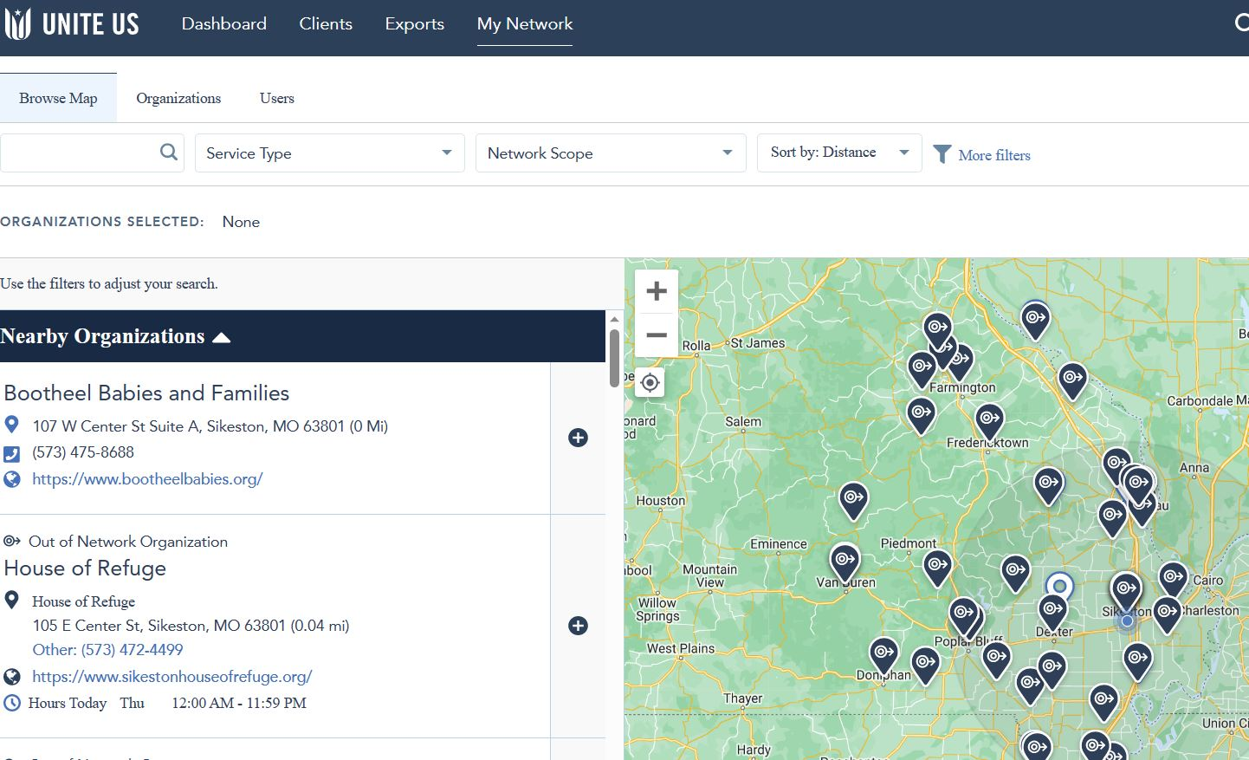


Slide 5

1st QUARTER DATA
1/1/24-3/31/24

Slide 6
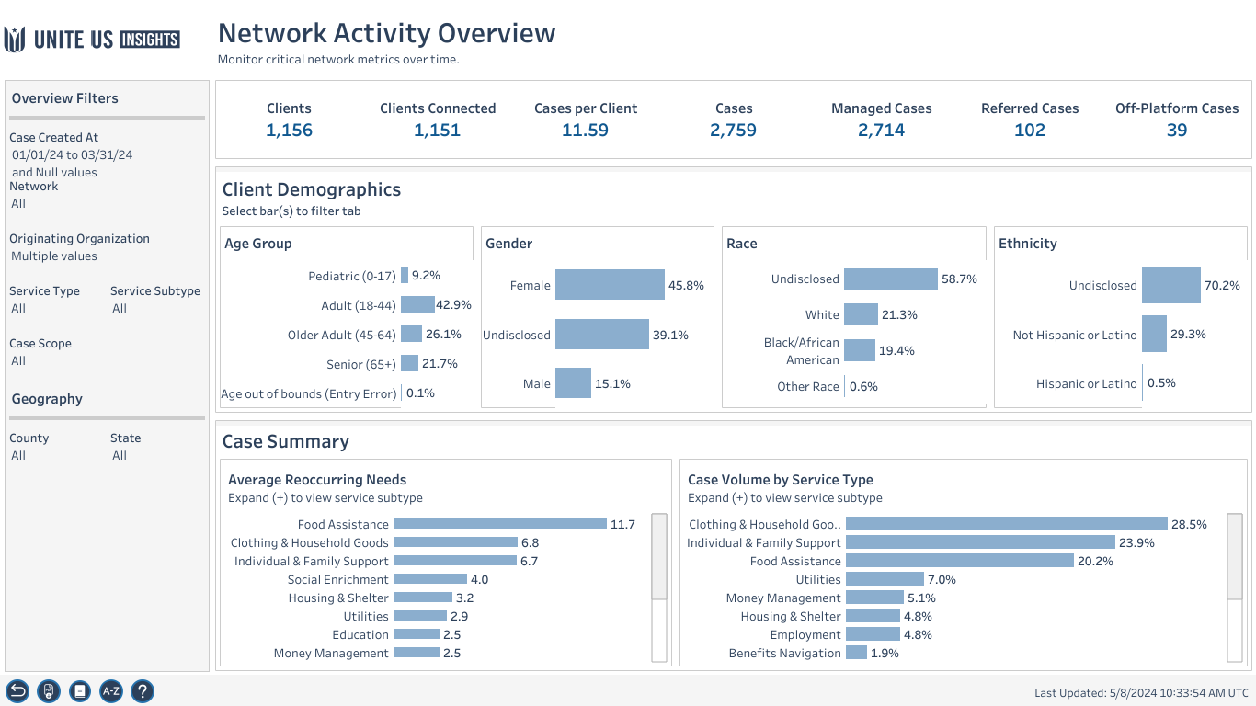
Workbook: Insights Center (uniteus.io)

Slide 7
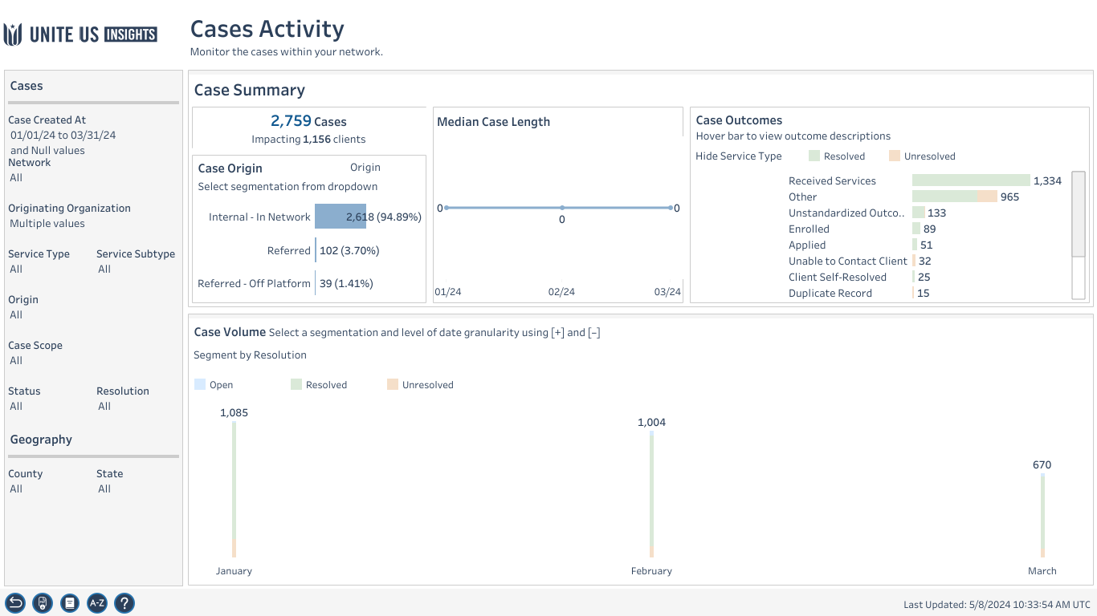

Slide 8
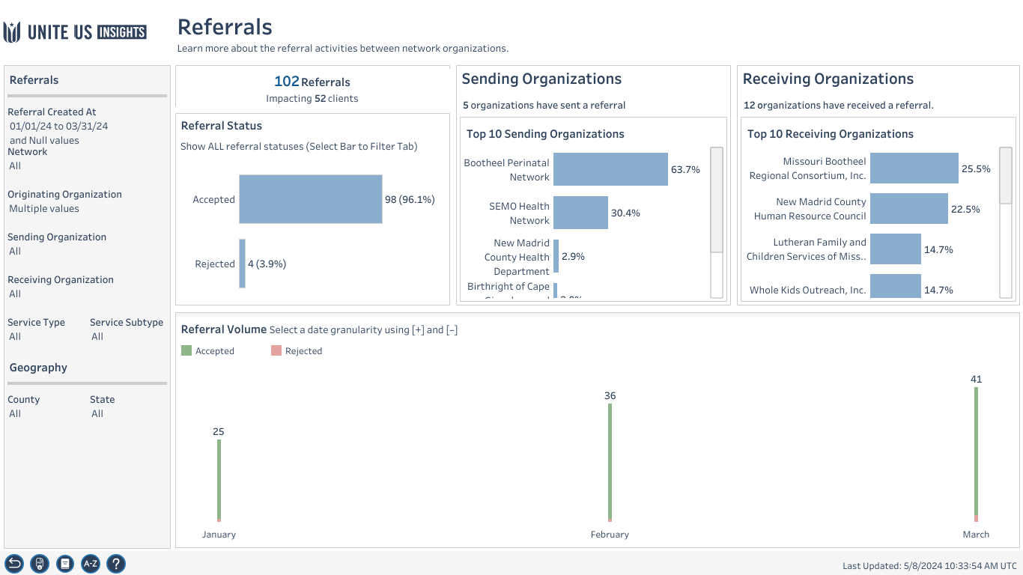
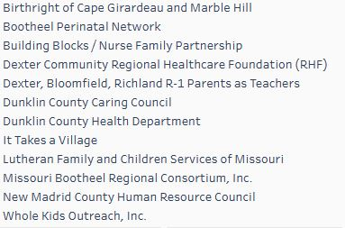
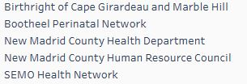

Slide 9
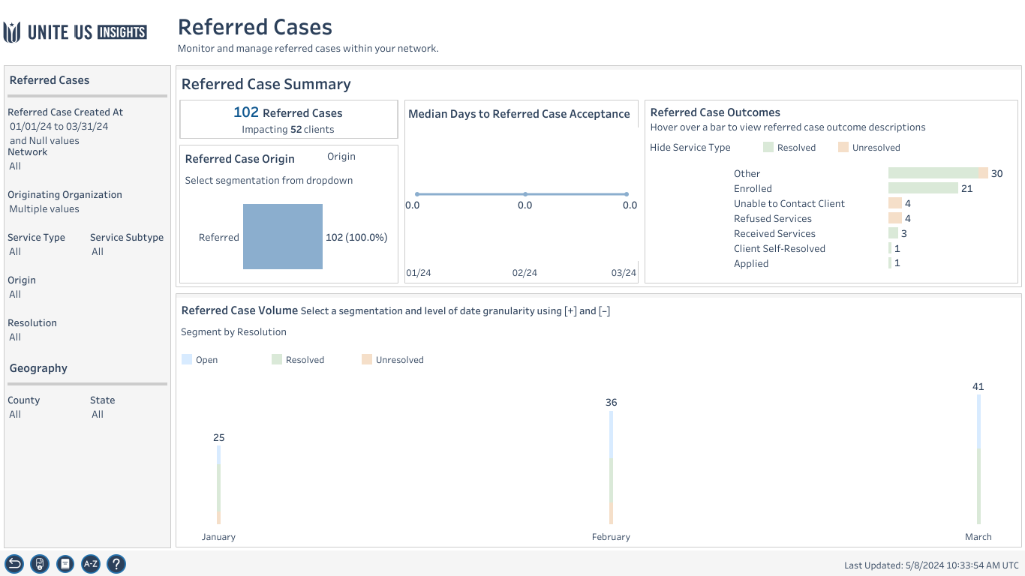

Slide 10
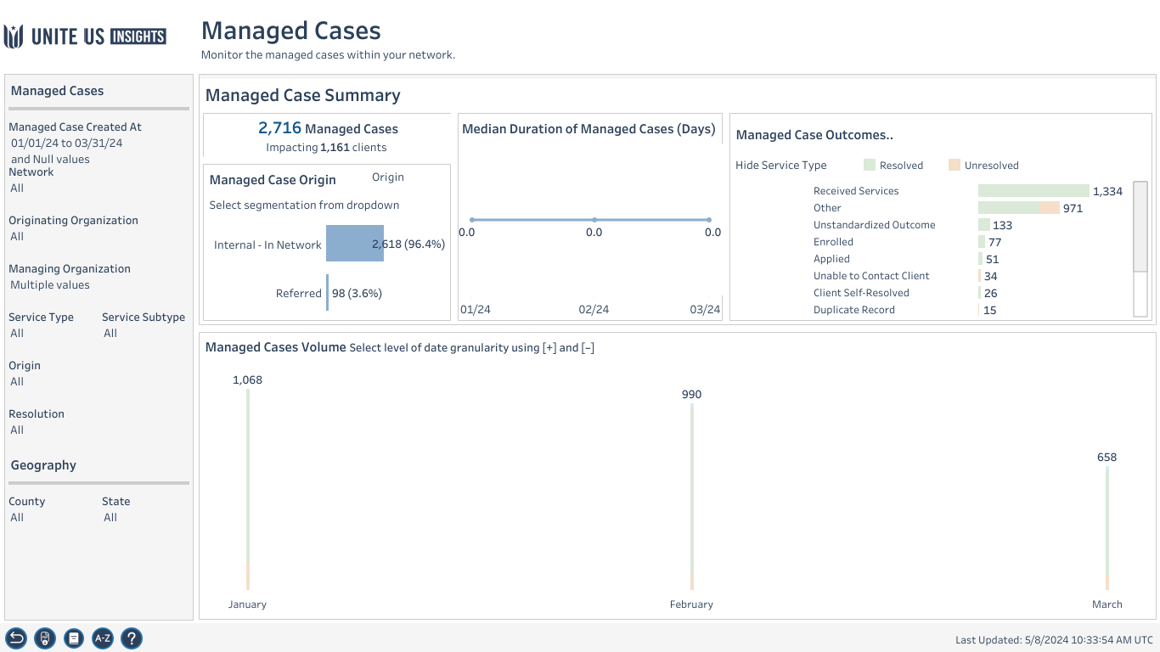

Slide 11

Top 5 referral partners in the 1st quarter 2024
Bootheel Babies and Families
Bootheel Perinatal Network
New Madrid County Health Department
New Madrid County Human Resource Council
SEMO Health Network

Slide 12

1st Quarter Health Equity
2024

Slide 13
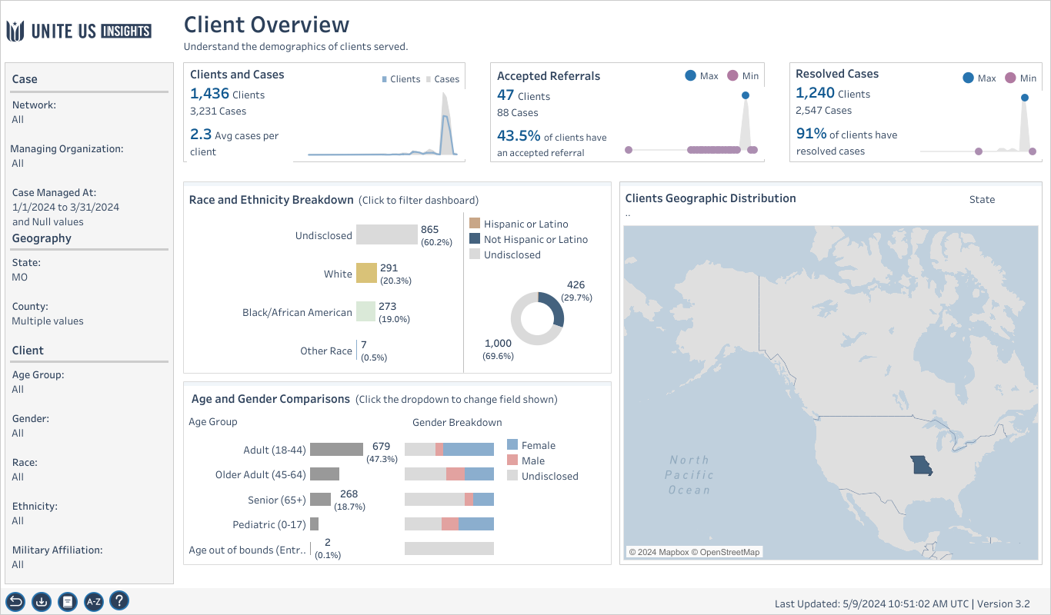

Slide 14
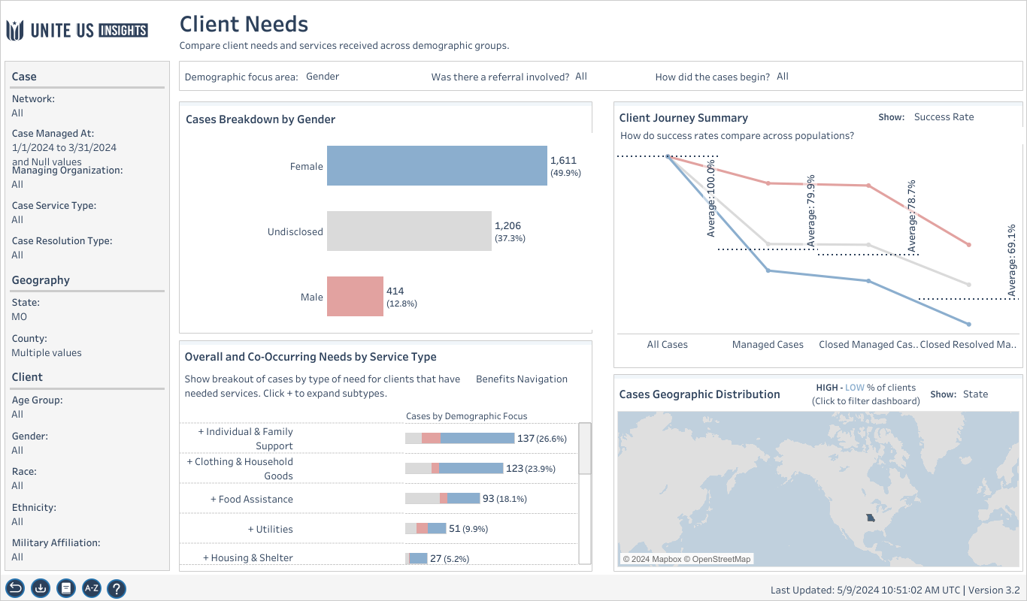

Slide 15
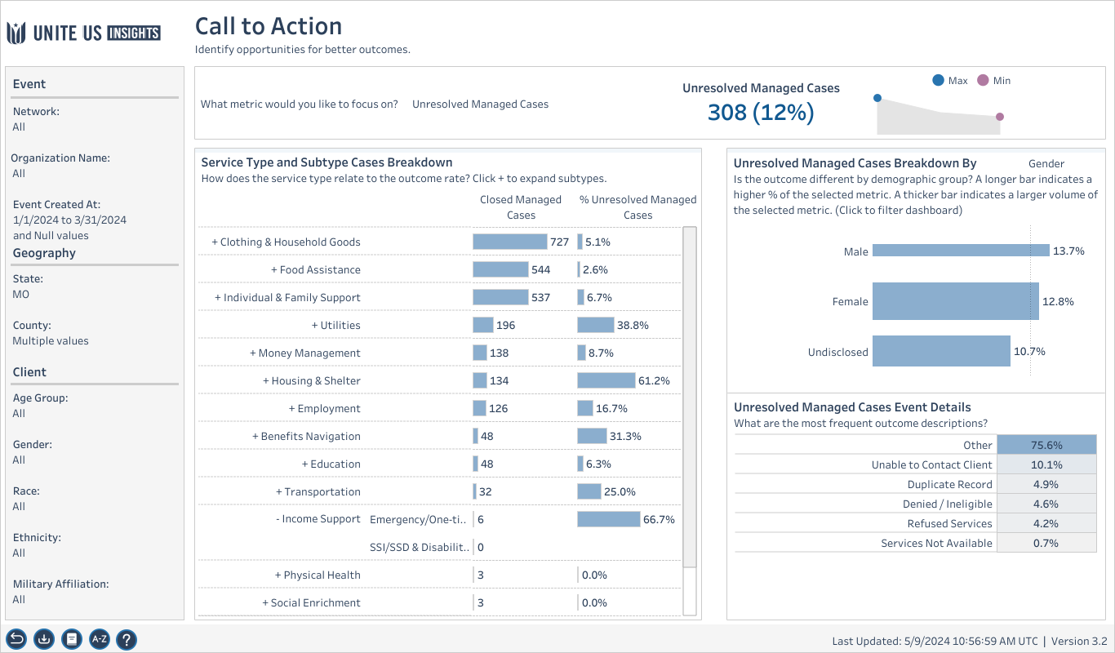

Slide 16
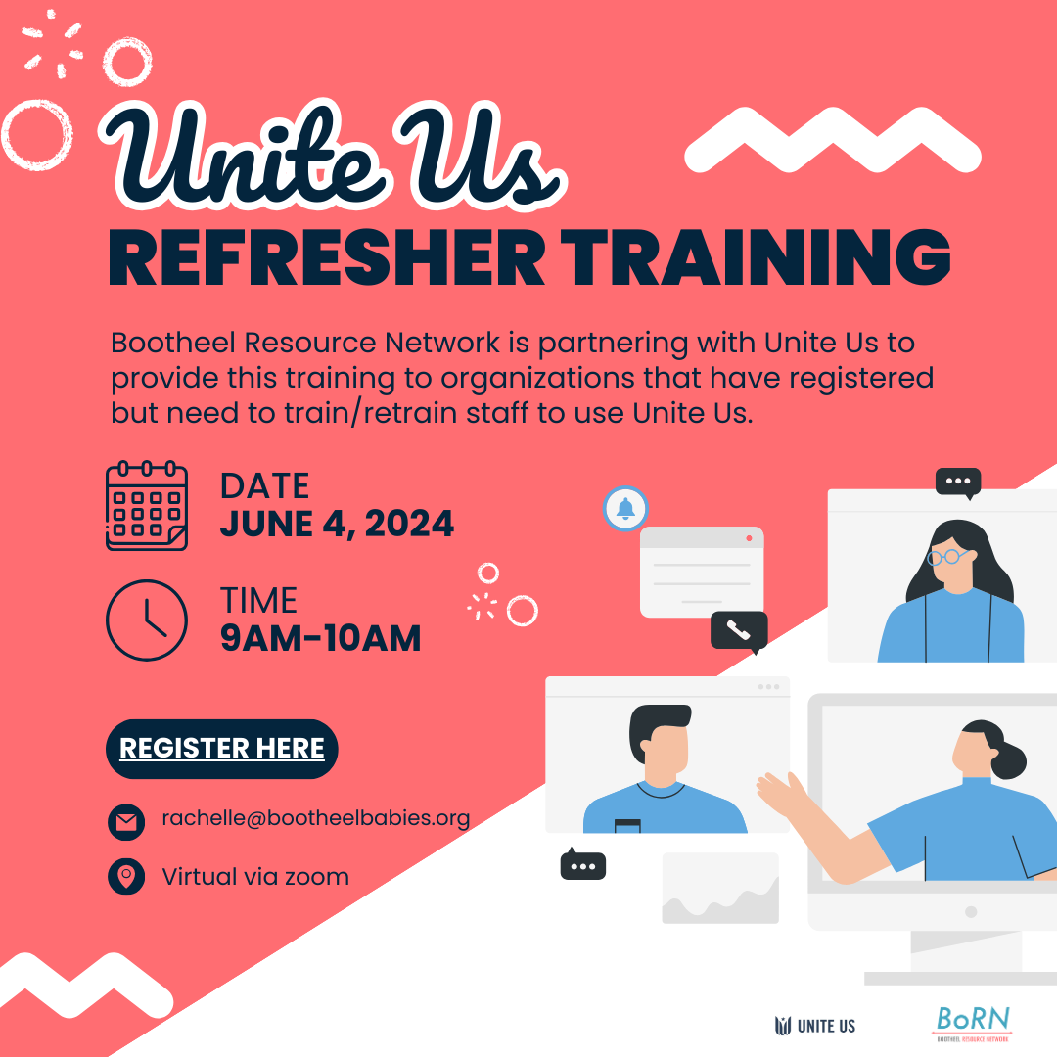
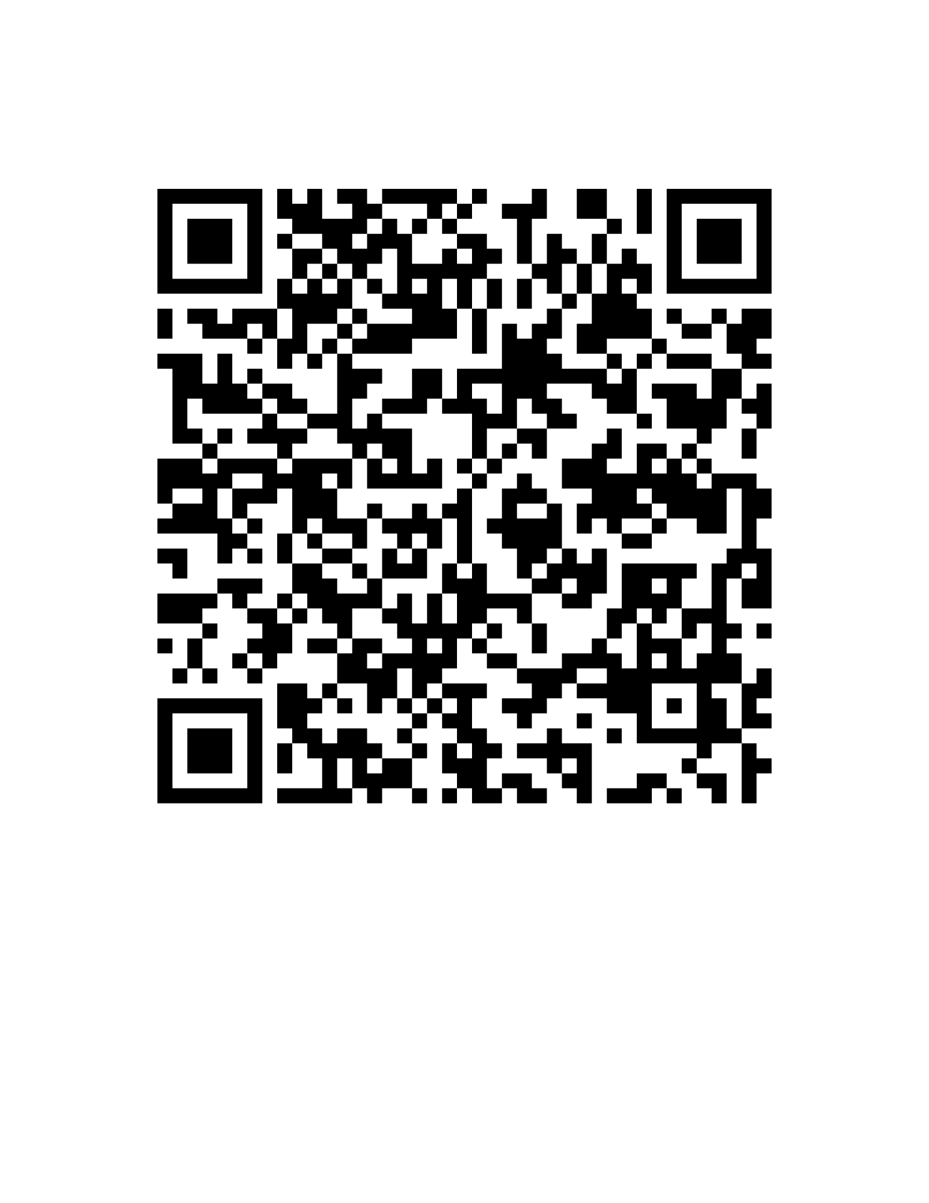
Notes:
https://uniteus.zoom.us/meeting/register/tJwvcO-vqz0pGdC8-VvsvUwHwMmcU_5G1Dm0#/registration

Slide 17
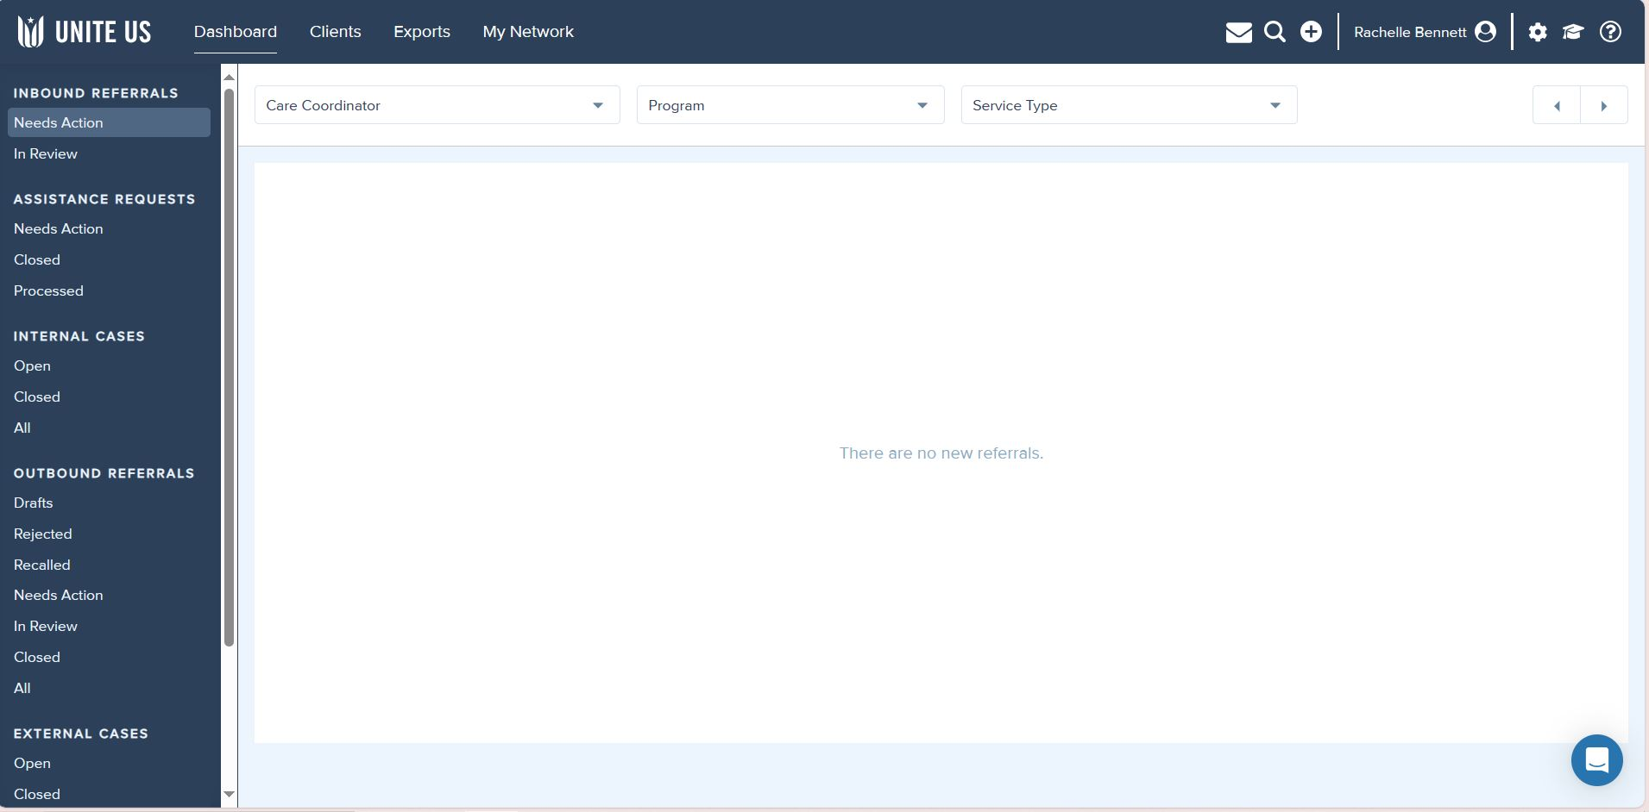

Slide 18
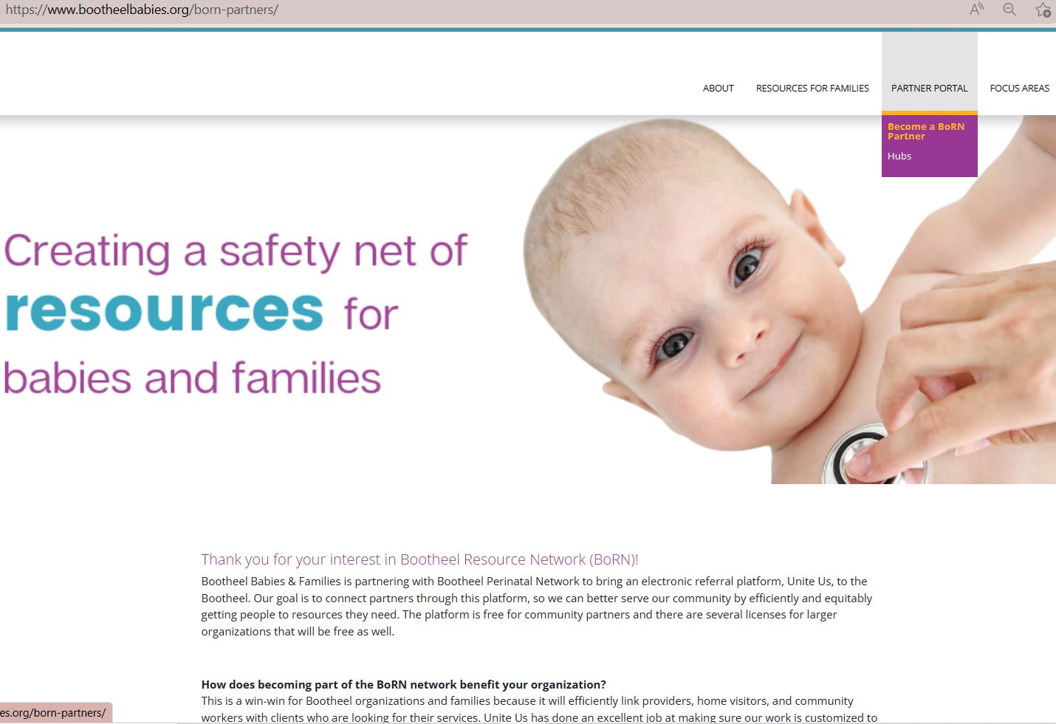
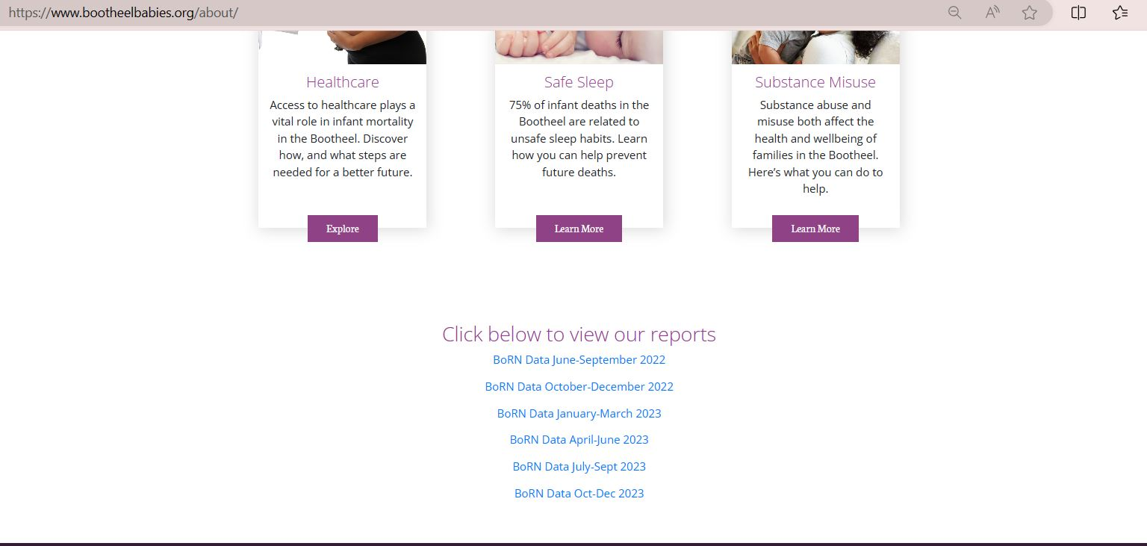

Information for potential partners on BBF website
Find this data on our BBF “about us page” bootheelbabies.org

Slide 19
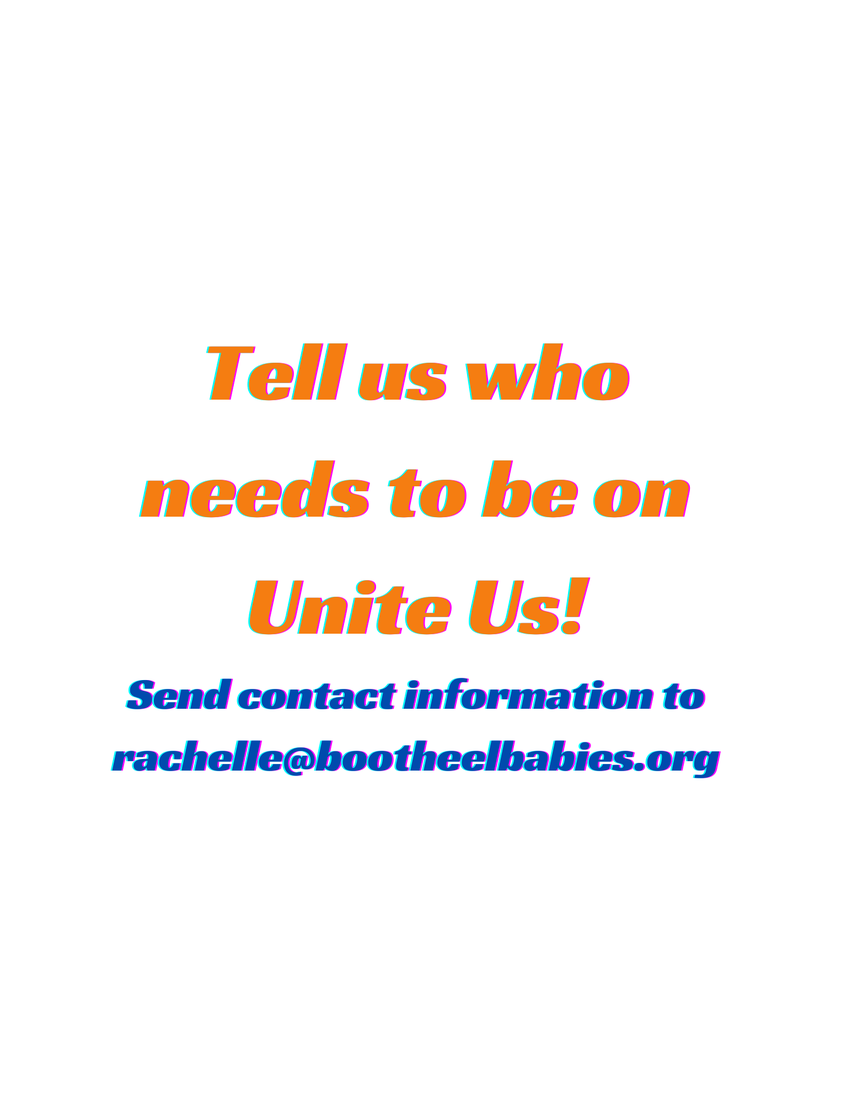

Slide 20


