Slide 1


BoRN + Unite Us
Data Report
10/01/2023-12/31/2023

Slide 2

Schedule a Workflow Conversation
Maura Newell
Costumer Success Manager
(703) 593-5458
maura.newell@uniteus.com
Submit Your Partner Registration Form
Attend a Software Training
Be a Network Champion
Notes:
So join us! Join us on this journey to create a community that has a solution that could ensure our community members in need receive resources that will help and drive outcomes of success. We are currently live in Saint Louis, and Kansas City, with plans of expanding throughout the state of Missouri by 2022.
Based on how you filled out the form I shared before the demo, I will reach out directly to support you in moving to the next step. In the meantime, here is my contact info.
Thank you!

Slide 3
Active Bootheel Resource Network partners on the Unite Us platform:
Birthright of Cape Girardeau and Marble Hill
Bootheel Babies and Families
Bootheel Perinatal Network
Building Blocks/ Nurse Family Partnership
Butler County Health Department
Cape Girardeau Co-Responder Unite (CRU)
Cape Girardeau County Public Health Center
Caring Communities-Missouri
Charleston R-1
Dexter Community Regional Healthcare Foundation
Dexter, Bloomfield, Richland R-1 Parents as Teachers
Dunklin County Health Department
Dunklin/Stoddard Caring Council
Fresh Start Self Improvement Center, Inc
It Takes a Village
Jackson R2 School District
Missouri Bootheel Regional Consortium, Inc. (MBRC)
Mississippi County Health Department
New Madrid County Health Department
New Madrid County Human Resource Council
Pemiscot County Health Dept
Pemiscot Initiative Network
SEMO Area Health Education Center
SEMO Health Network
Stoddard County Public Health Center
Visiting Nurse Association of Southeast Missouri
Whole Kids Outreach, Inc.
Notes:
Don’t forget about statewide partners! You find more by clicking the “MyNetwork” tab at the top of your Unite Us page. These include organizations like Mers Goodwill, Lutheran Family and Children’s Services, and Catholic Charties.

Slide 4
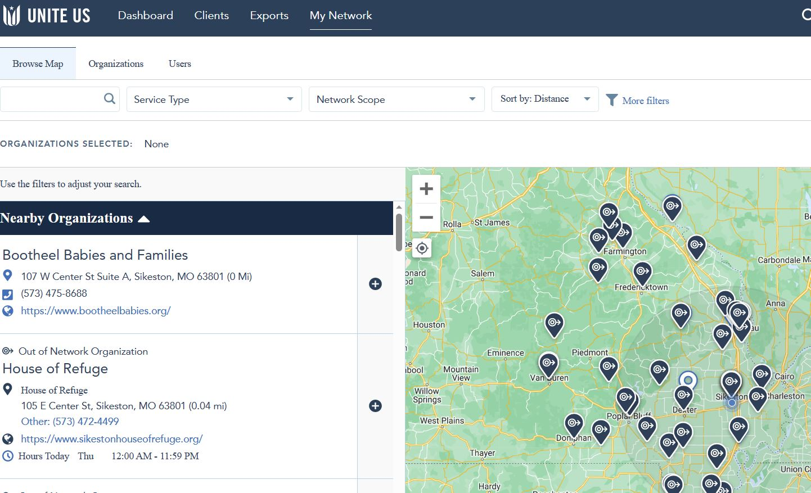


Slide 5

4th QUARTER DATA
10/01/2023-12/31/23

Slide 6
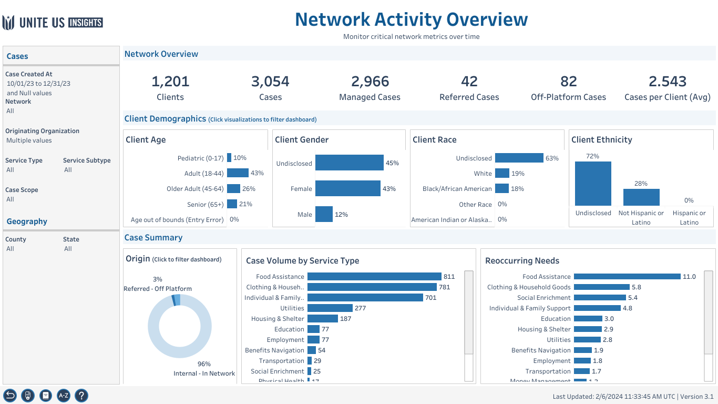
Workbook: Insights Center (uniteus.io)

Slide 7
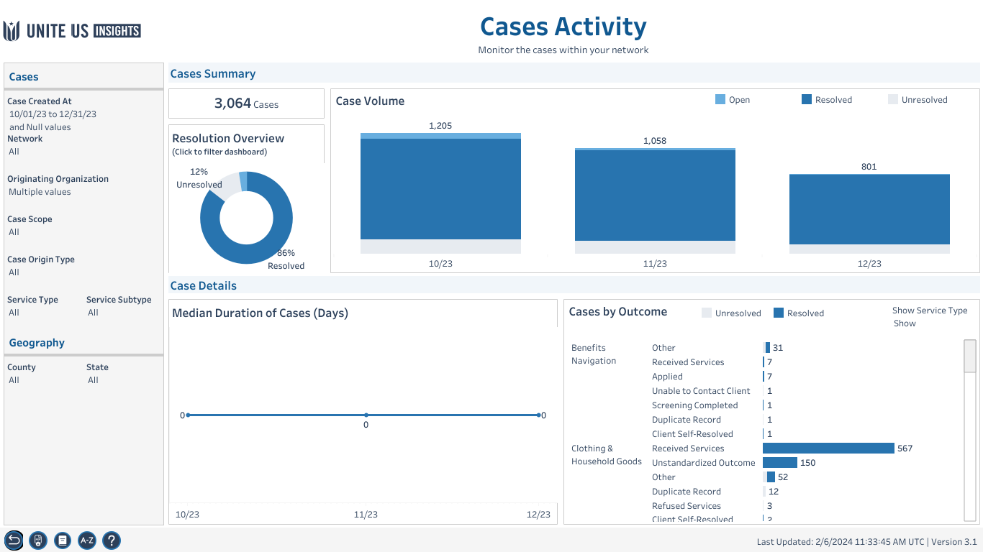

Slide 8
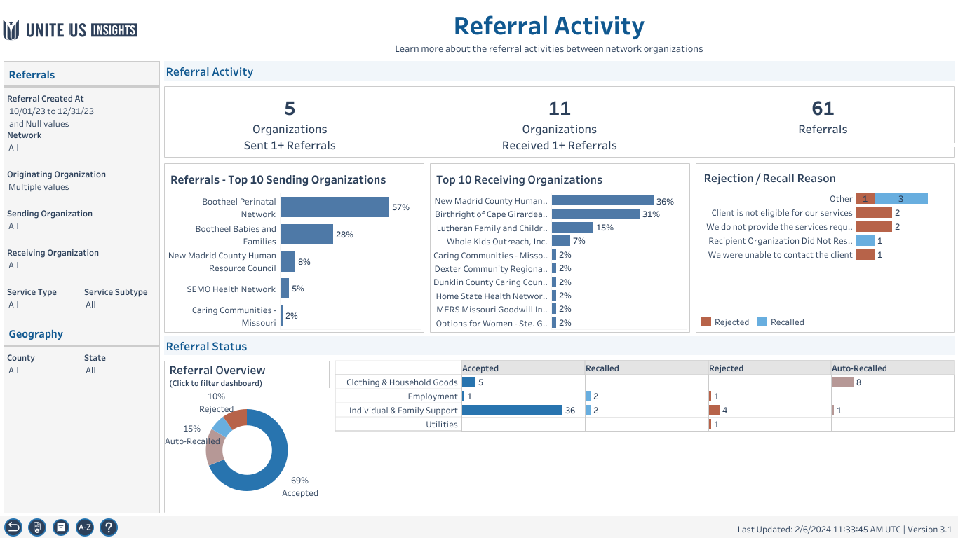


Slide 9
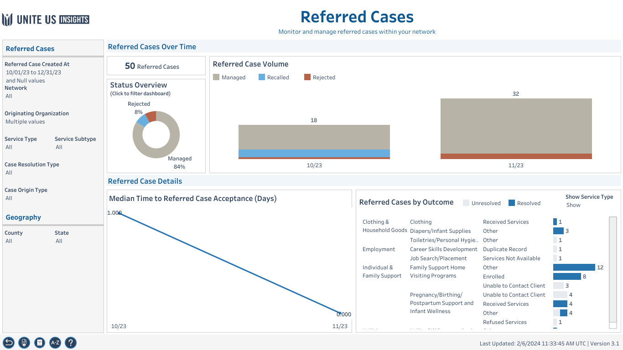

Slide 10
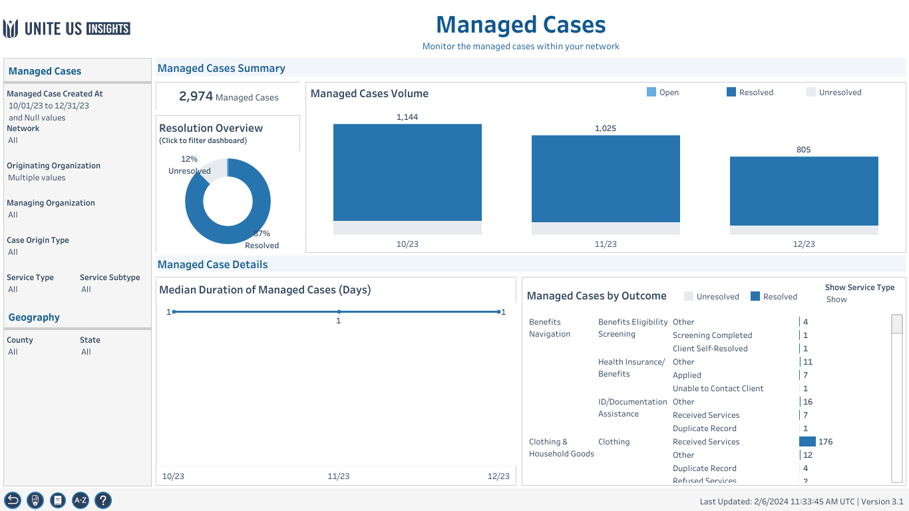

Slide 11

Top 5 referral partners in the 4th quarter:
Bootheel Babies and Families
Bootheel Perinatal Network
Caring Communities
New Madrid County Human Resource Council
SEMO Health Network

Slide 12

Year Overview and Health Equity
2023

Slide 13
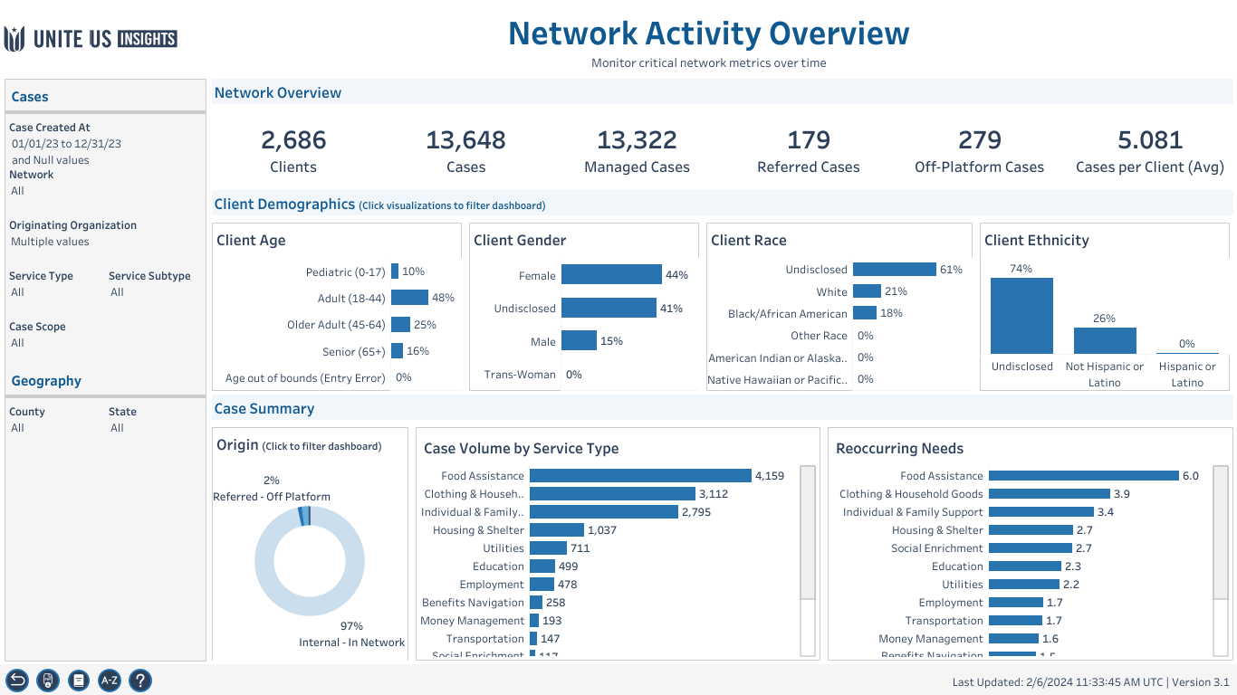

Slide 14
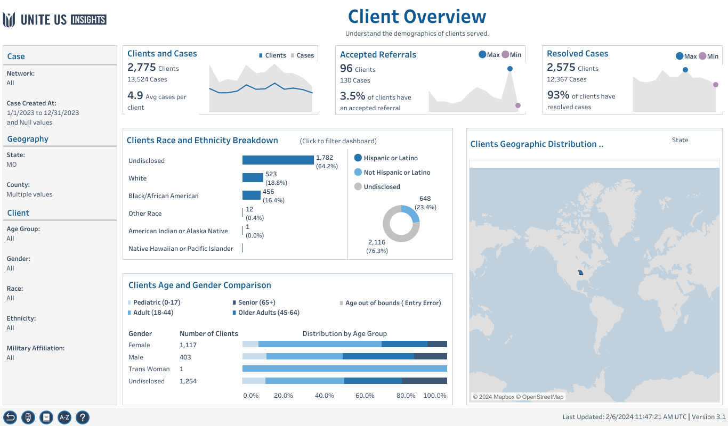

Slide 15
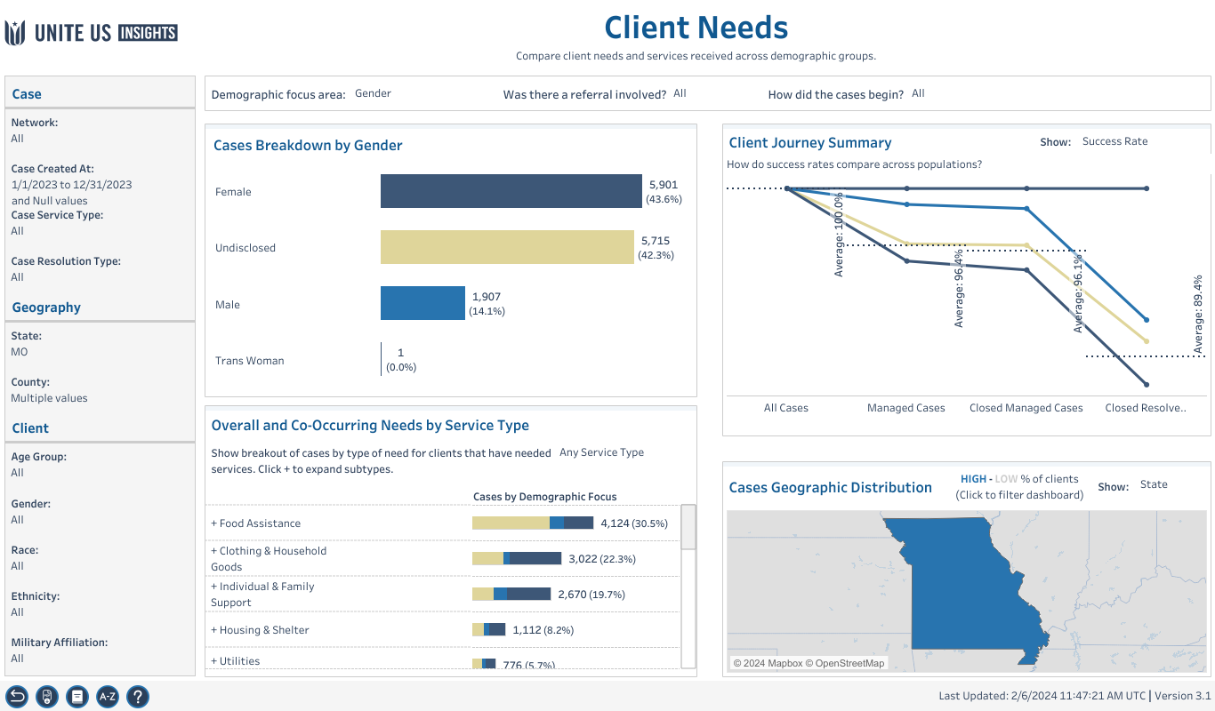

Slide 16
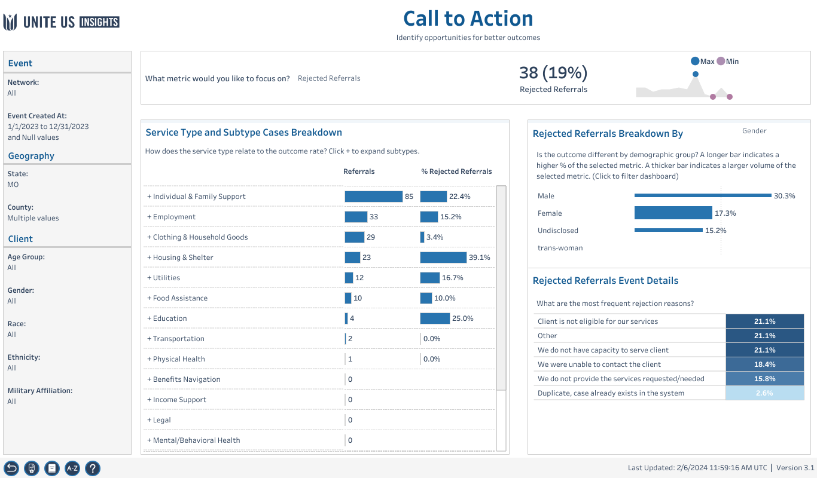

Slide 17
Future data presentation dates
TBD
Future virtual info sessions
February 15, 2024 10a-11a virtual
March 21, 2024 10a-11a virtual
April 18, 2024 10a-11a virtual
Register here->Meeting Registration - Zoom

Slide 18
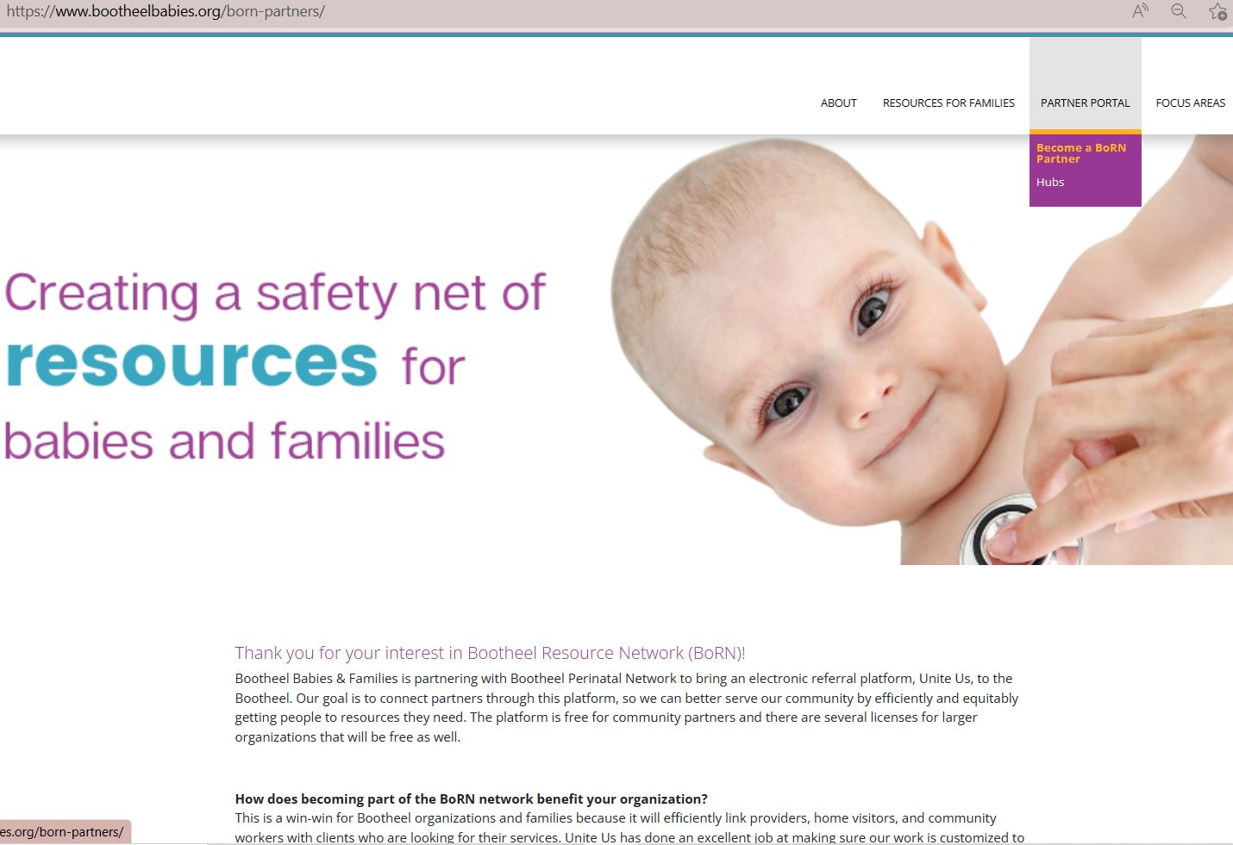
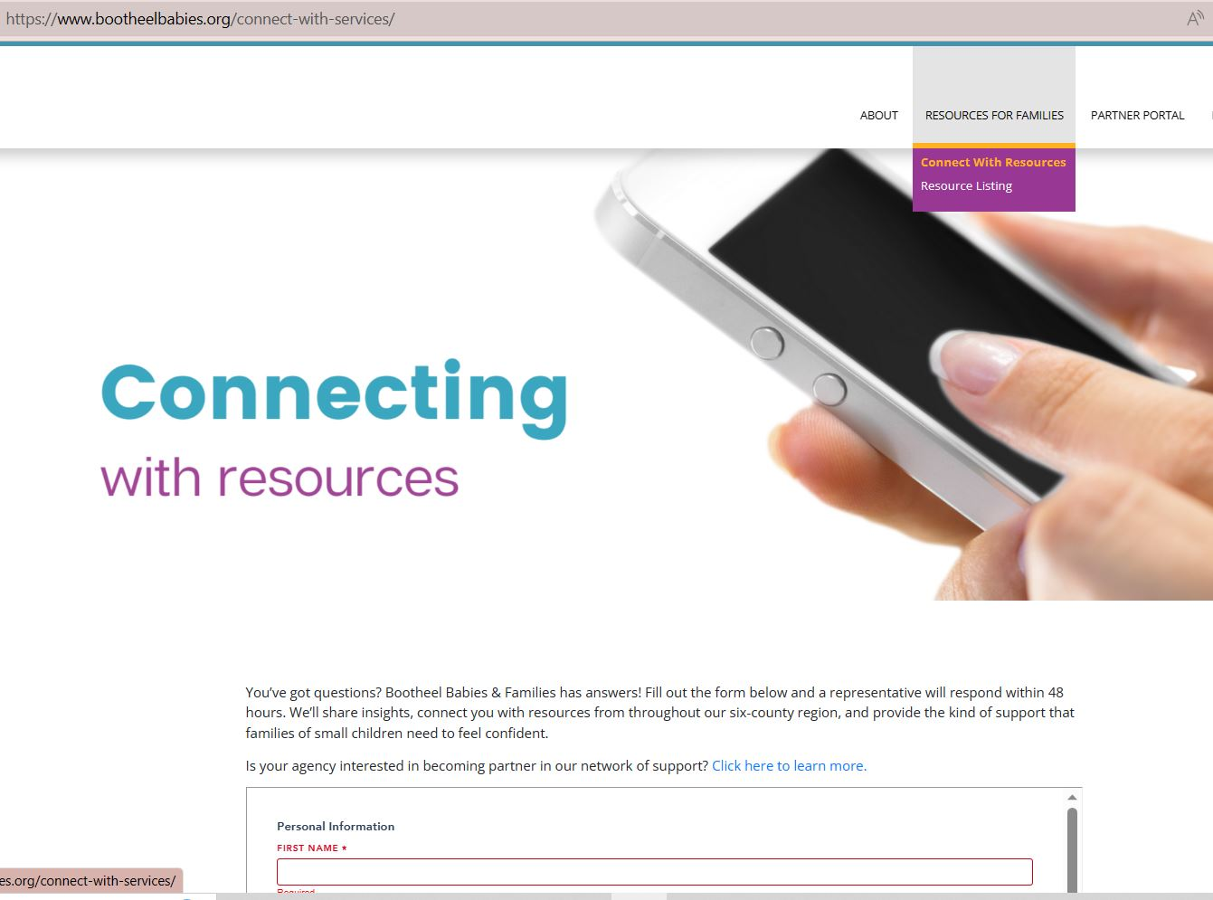

Self referral link on BBF website bootheelbabies.org
Information for potential partners on BBF website

Slide 19
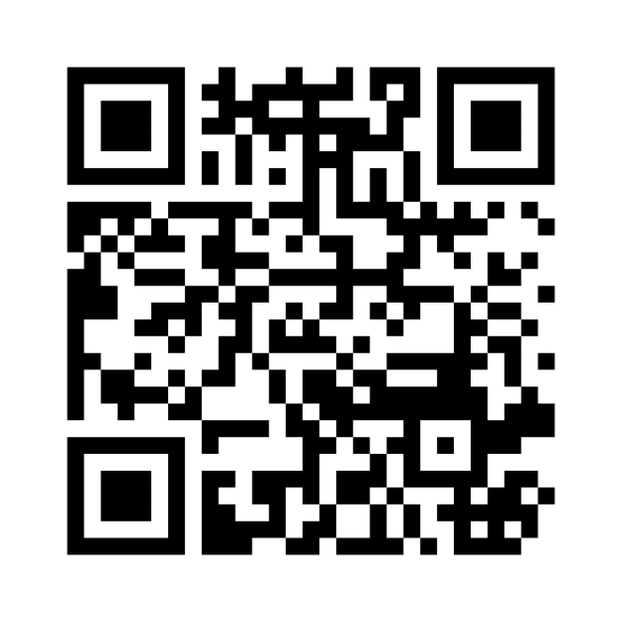
https://www.menti.com/al51r688ztcw
Notes:
https://www.menti.com/al51r688ztcw

