Slide 1
BoRN + Unite Us Data Report
Celebrating 1 year
6/27/2022-6/30/2023

Slide 2
INTRODUCTIONS:
First and Last Name
Organization you work for (if applicable)
Counties you serve (if applicable)
BONUS:
What is your favorite place to eat in southeast MO?

Slide 3
Active Bootheel Resource Network partners on the Unite Us platform:
Birthright of Cape Girardeau and Marble Hill
Bootheel Babies and Families
Bootheel Perinatal Network
Building Blocks/ Nurse Family Partnership
Butler County Health Department
Caring Communities-Missouri
Charleston R-1
Dexter Community Regional Healthcare Foundation
Dexter, Bloomfield, Richland R-1 Parents as Teachers
Dunklin County Health Department
Dunklin/Stoddard Caring Council
Fresh Start Self Improvement Center, Inc
Jackson R2 School District
Mississippi County Health Department
New Madrid County Human Resource Council
Pemiscot County Health Dept
Pemiscot Initiative Network
SEMO Area Health Education Center
SEMO Health Network
Stoddard County Public Health Center
The Resource Link of SEMO
Visiting Nurse Association of Southeast Missouri
Don’t forget about statewide partners! You find more by clicking the “MyNetwork” tab at the top of your Unite Us page. These include organizations like Mers Goodwill, Lutheran Family and Children’s Services, and Catholic Charties.

Slide 4
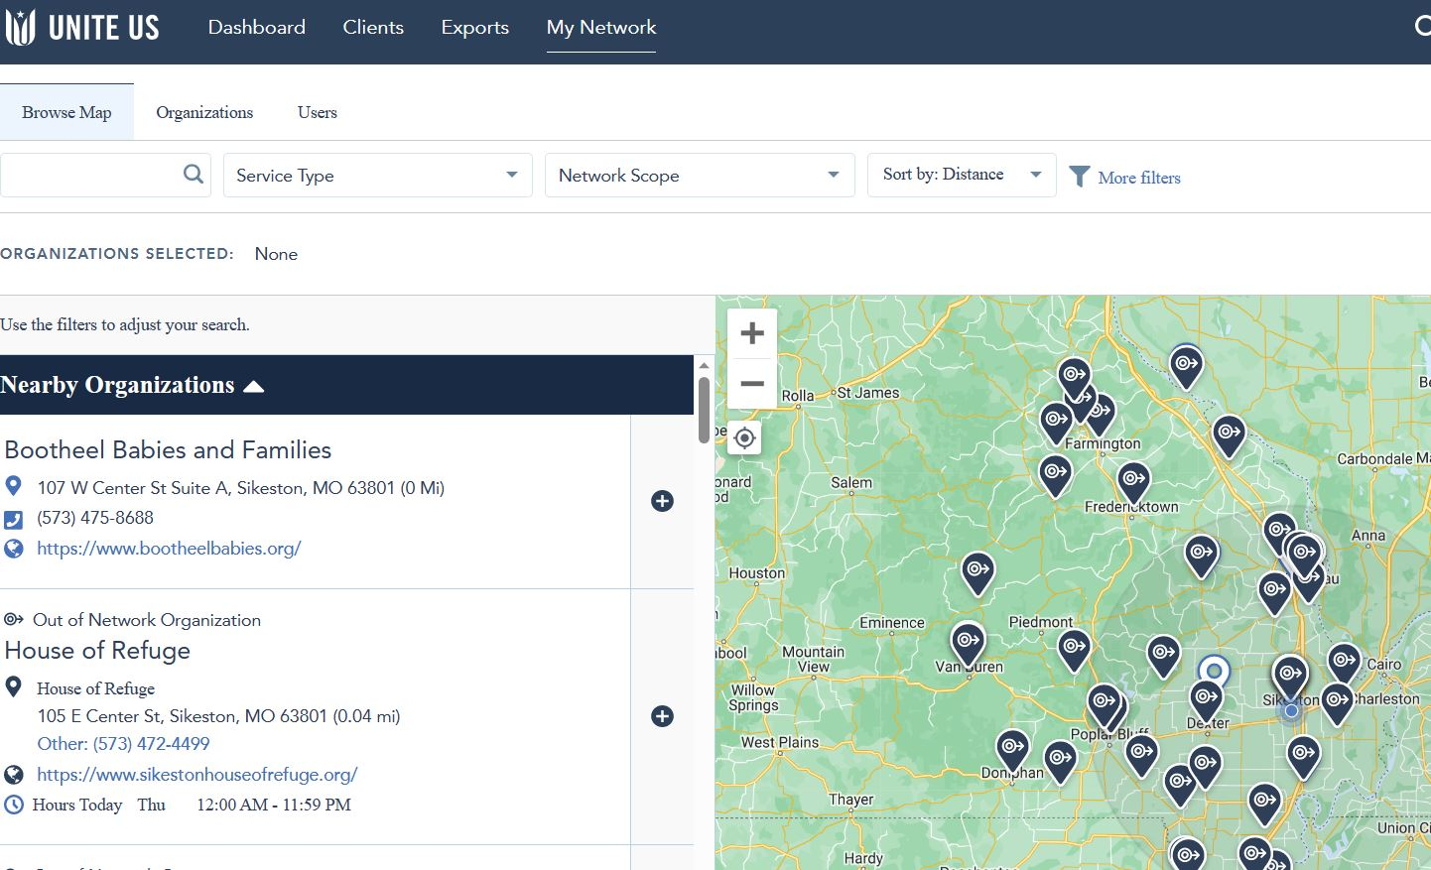

Slide 5
4th
QUARTER
DATA
4/1/23-6/30/23

Slide 6
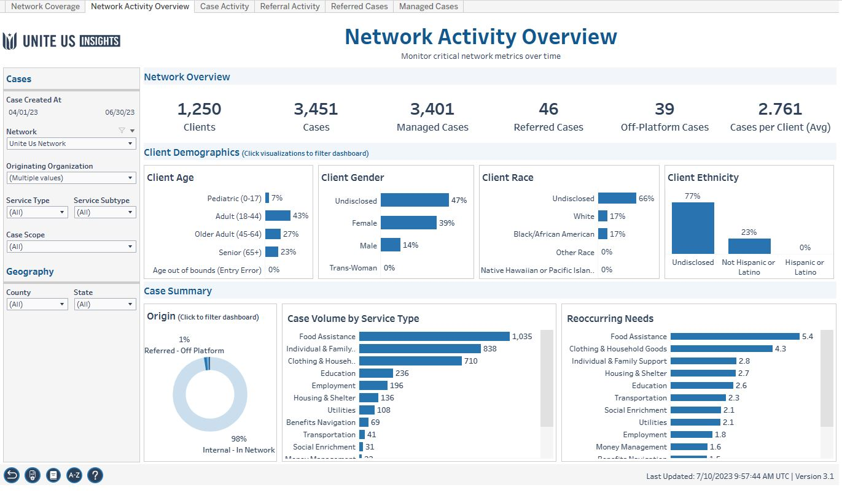
Workbook: Insights Center (uniteus.io)

Slide 7
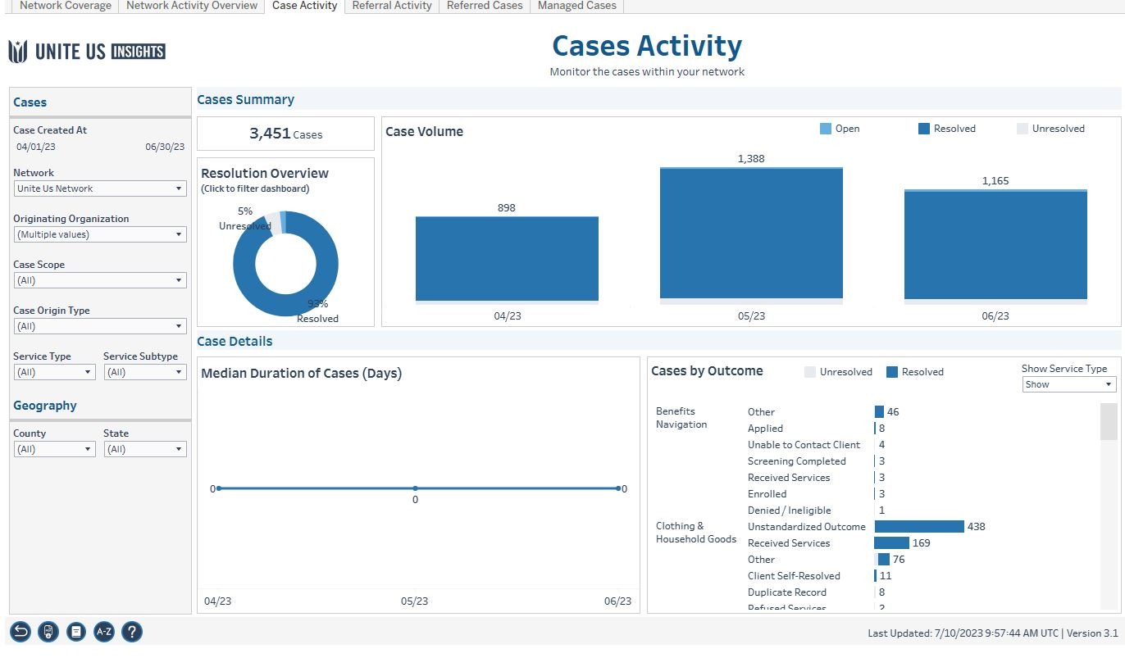

Slide 8
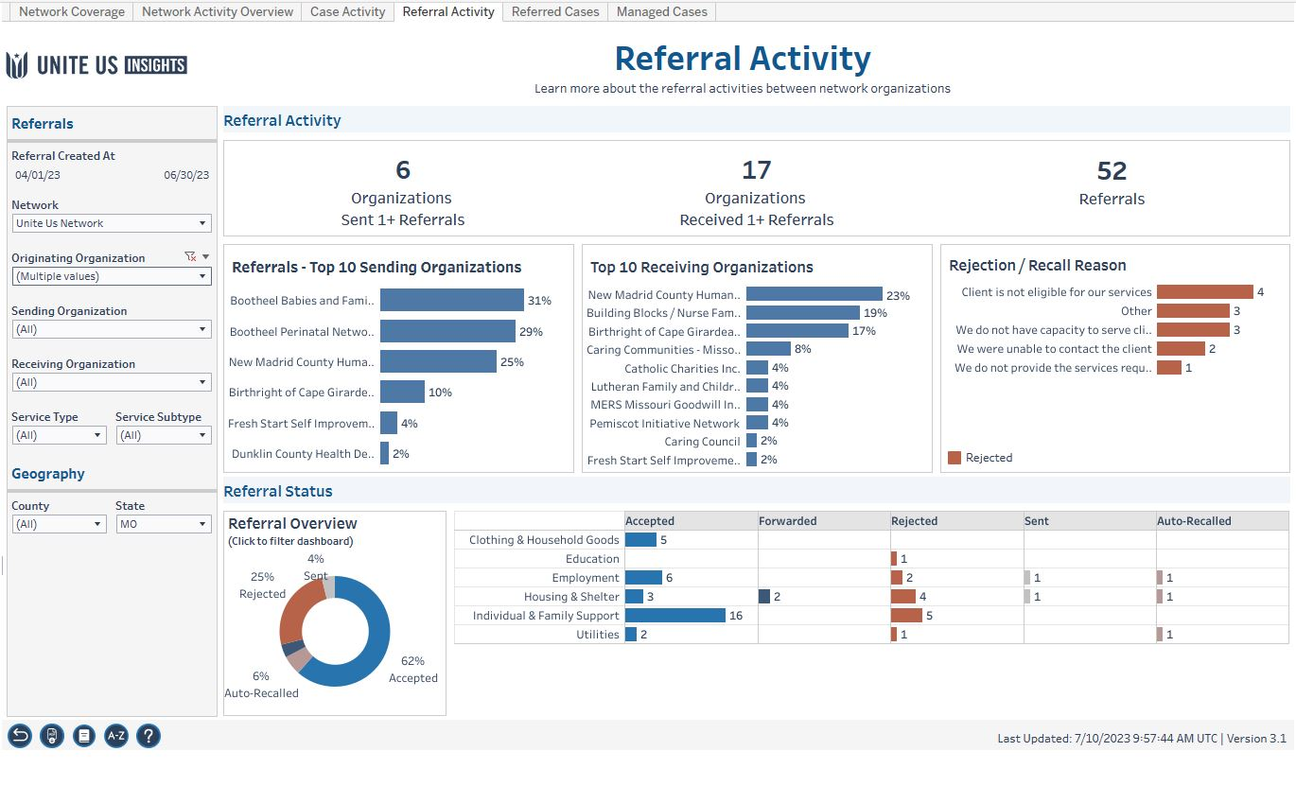

Slide 9
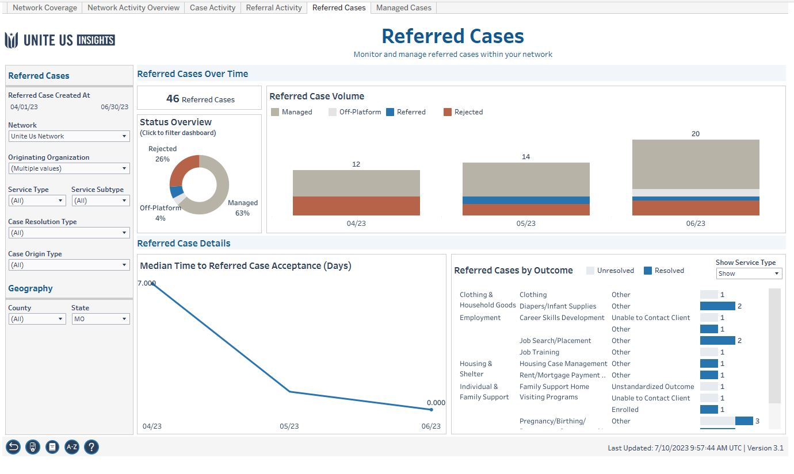

Slide 11
Year Overview and Health Equity
6/27/2022-6/30/2023

Slide 12
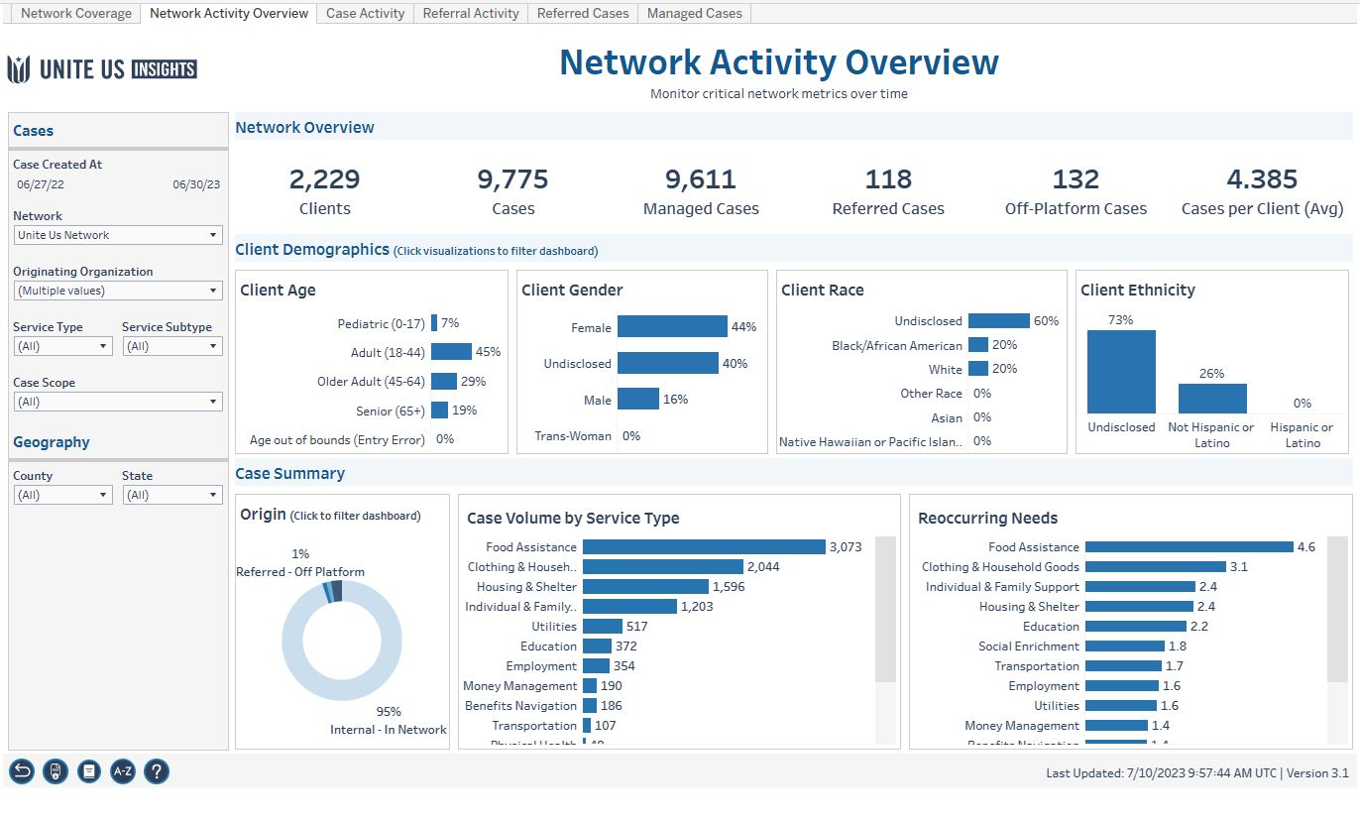

Slide 13
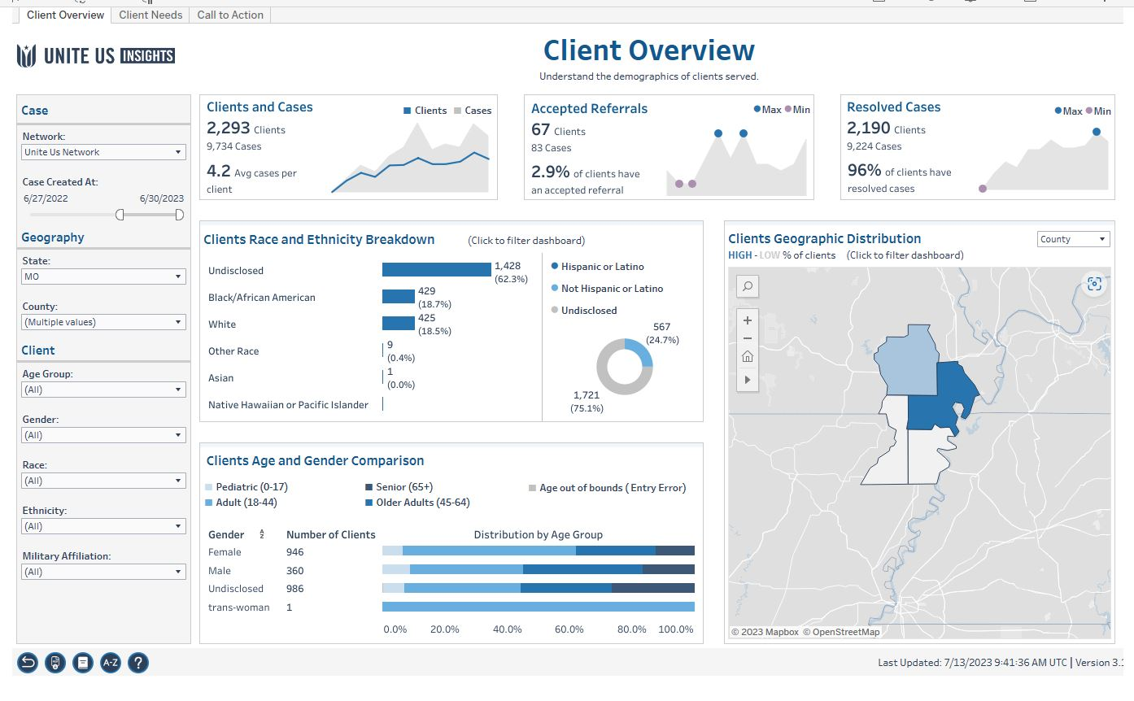

Slide 14
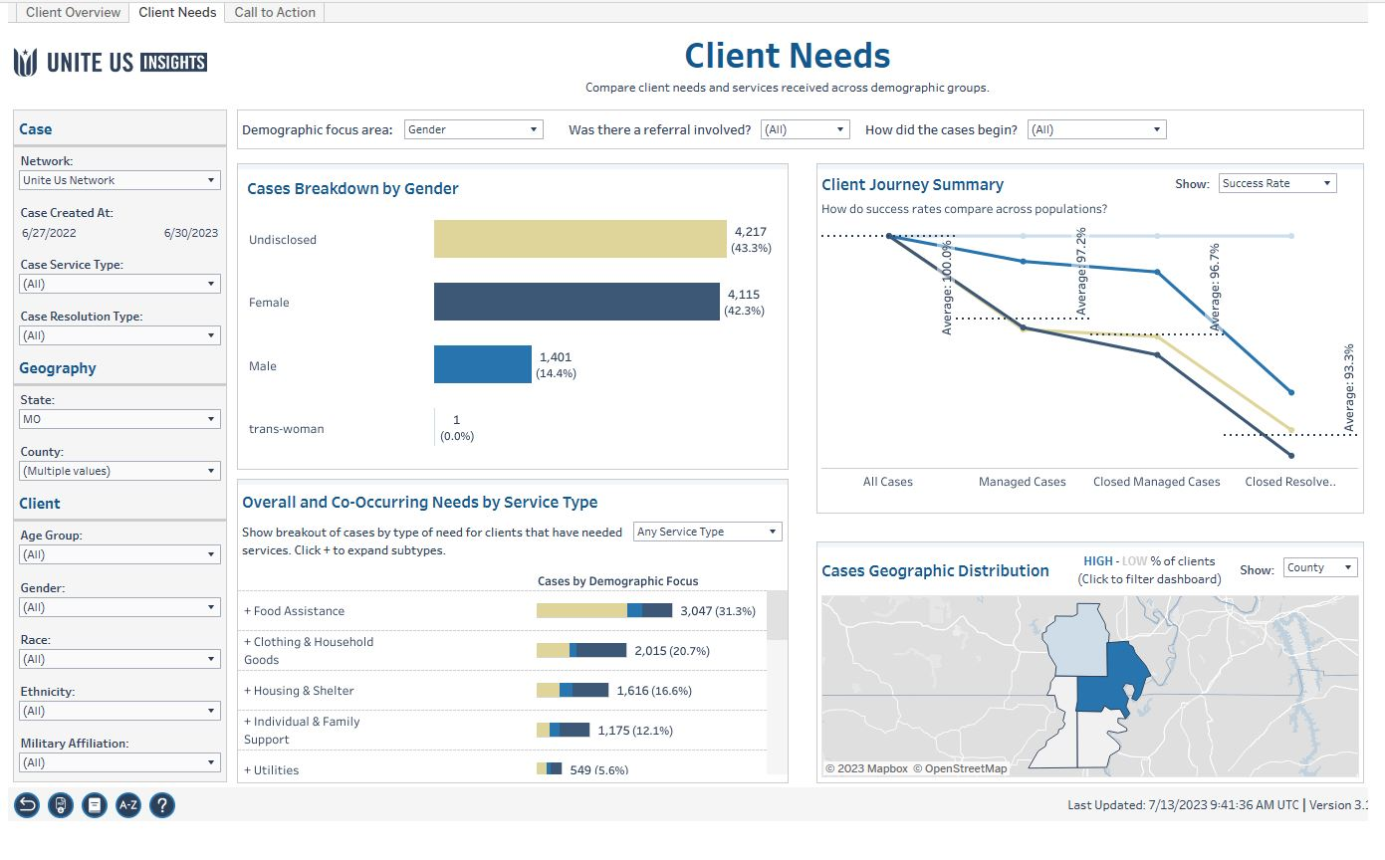

Slide 15
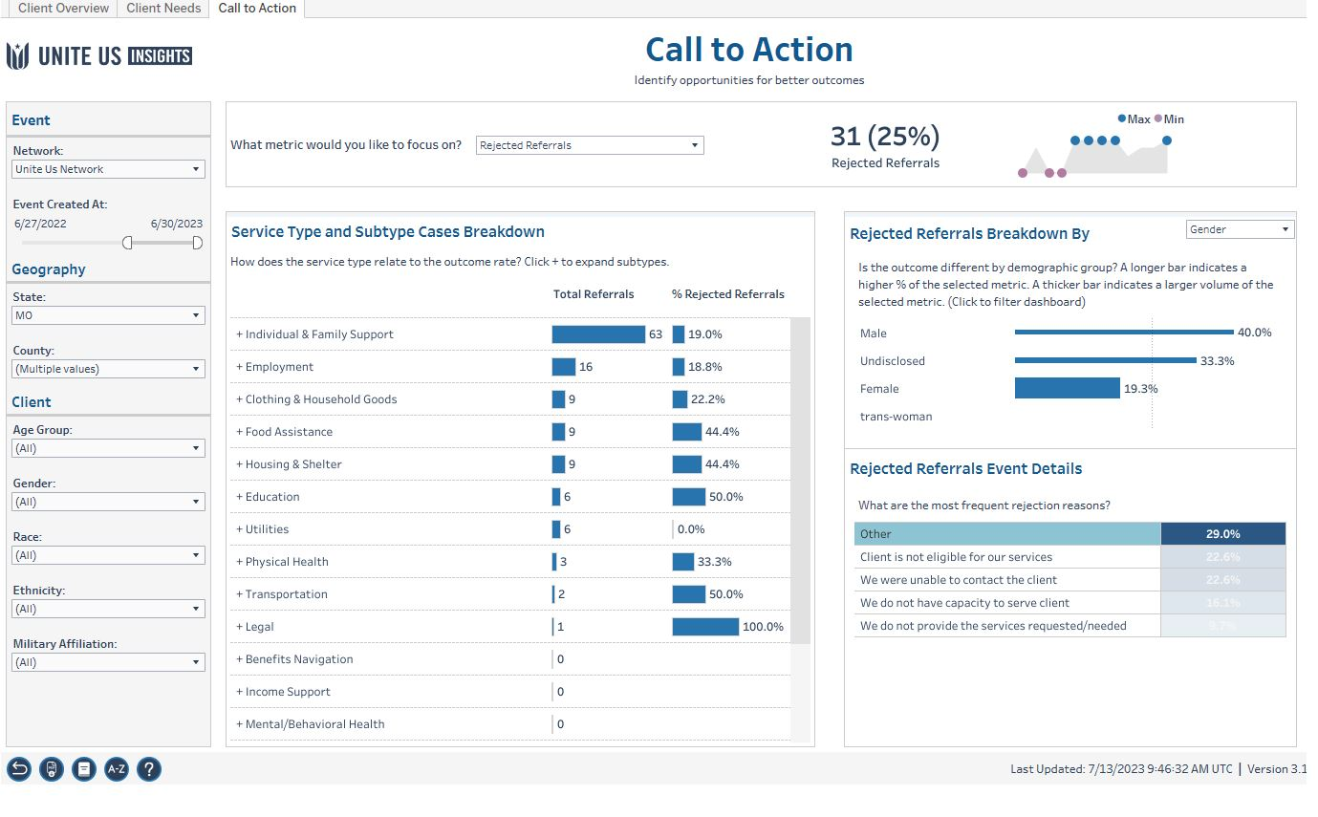

Slide 17
Follow up from survey last quarter

Slide 18
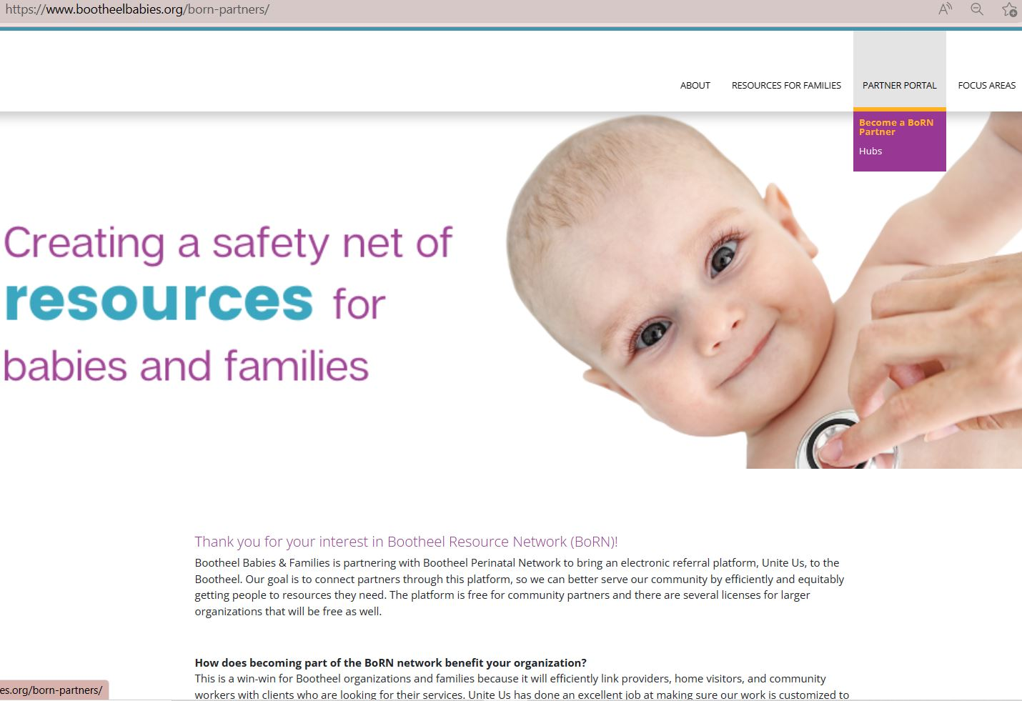
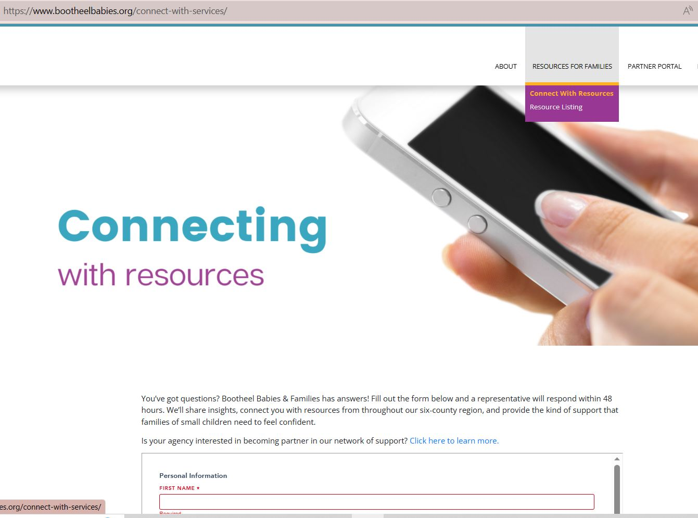
Self referral link on BBF website bootheelbabies.org
Information for potential partners on BBF website

Slide 19
Future data presentation dates
Oct 12, 2023 11a-1p in person, location tbd
Future virtual info sessions
August 17, 2023 10a-11a virtual
September 21, 2023 10a-11a virtual
October 19, 2023 10a-11a virtual
Register here->Meeting Registration - Zoom

