Slide 1
BoRN + Unite Us Data Report
9/28/22-12/31/22
2nd Quarter

Slide 3
INTRODUCTIONS:
Please share in chat:
First and Last Name
Organization you work for (if applicable)
Counties you serve (if applicable)

Slide 4
Current list of (regional) partners:
Don’t forget about statewide partners! You find more by clicking the “MyNetwork” tab at the top of your Unite Us page. These include Catholic Charities, Mers Goodwill, Lutheran Family and Children’s Services, and more.
Bootheel Perinatal Network | Fresh Start Self Improvement Center, Inc
New Madrid County Human Resource Council | Jackson R2 School District
Dexter, Bloomfield, Richland R-1 Parents as Teachers | Charleston R-1
Dexter Community Regional Healthcare Foundation (RHF) | Mississippi County Health Department
SEMO Area Health Education Center | The Resource Link of SEMO
Building Blocks/ Nurse Family Partnership | Dunklin County Health Department
SEMO Health Network | Pemiscot County Health Dept
Pemiscot Initiative Network (Skill Up) | Dunklin Stoddard Caring Council
Visiting Nurse Association of Southeast Missouri | Butler County Health Department
Stoddard County Public Health Center | Caring Communities pending UU registration

Slide 5
Updated website
Bootheel Babies – Bootheel Babies and Families is a comprehensive community effort to reduce infant mortality in Southeast Missouri

Slide 6
2nd
QUARTER
DATA
9/28/22-12/31/22

Slide 7
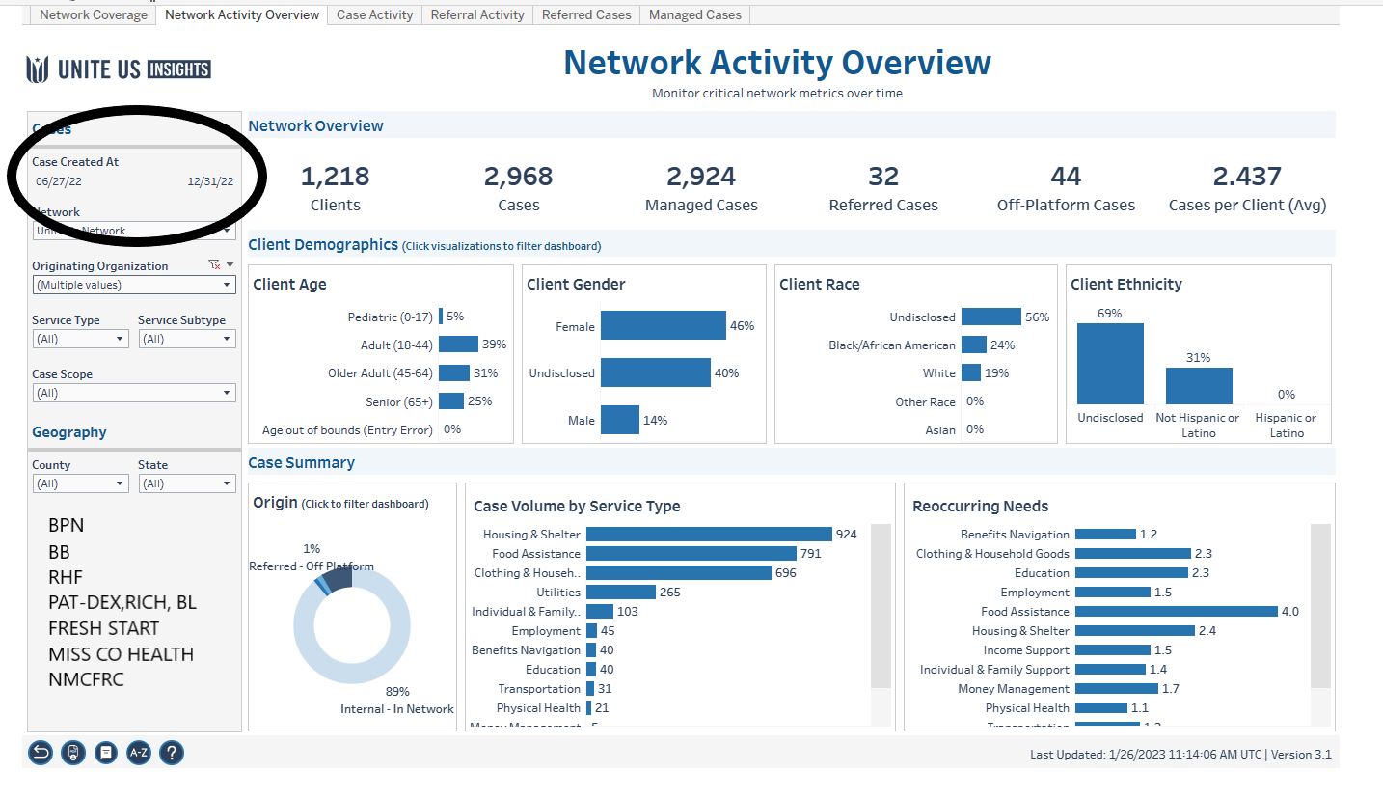
Workbook: Insights Center (uniteus.io)

Slide 8
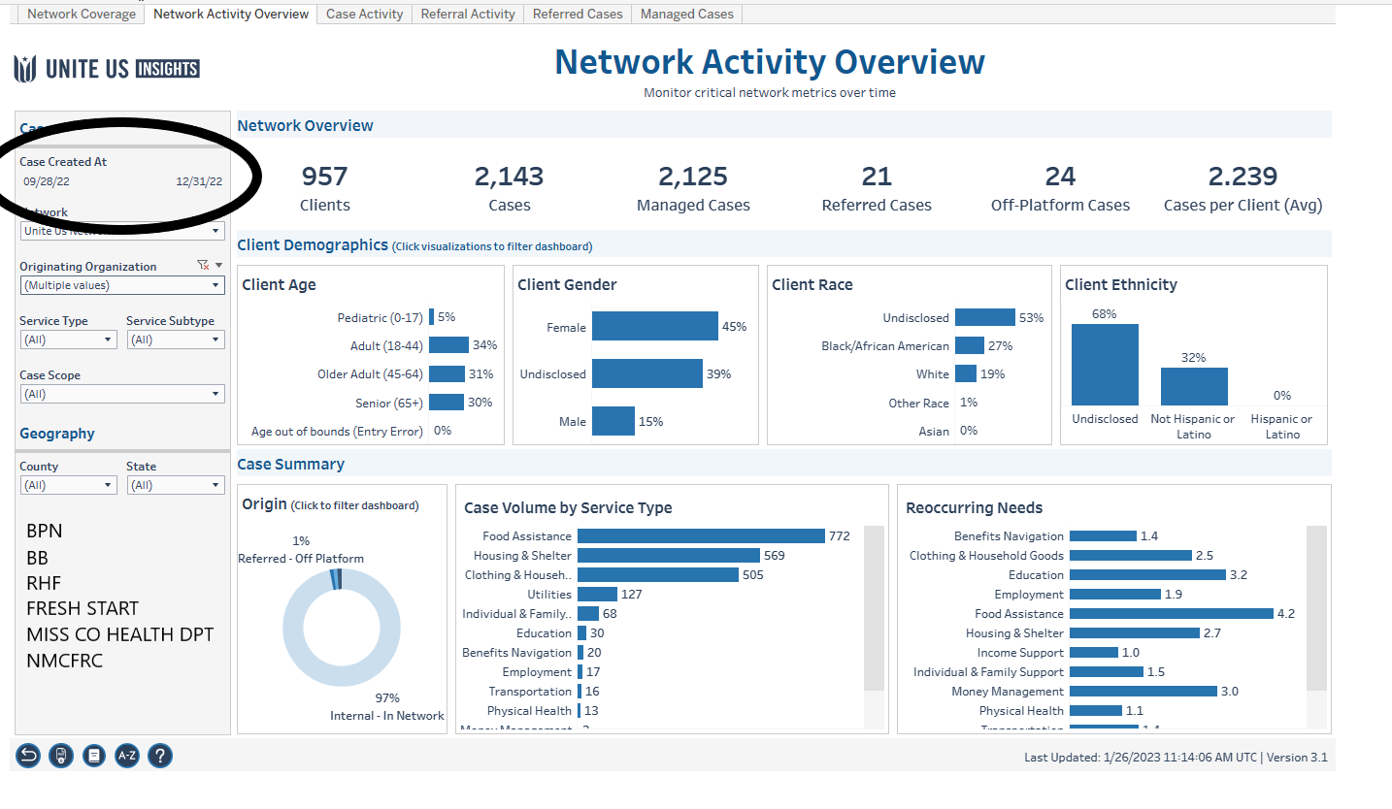

Slide 9
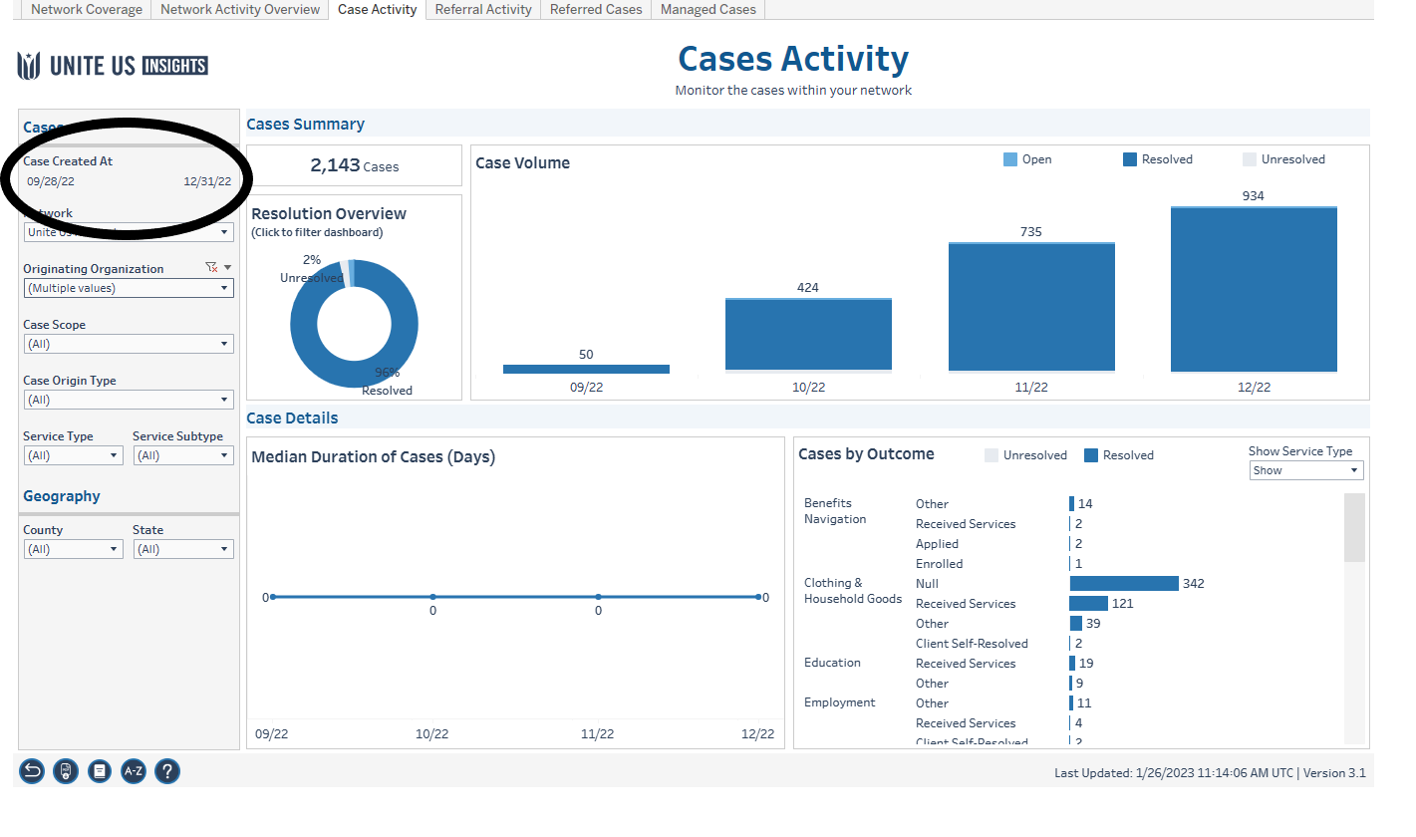

Slide 10
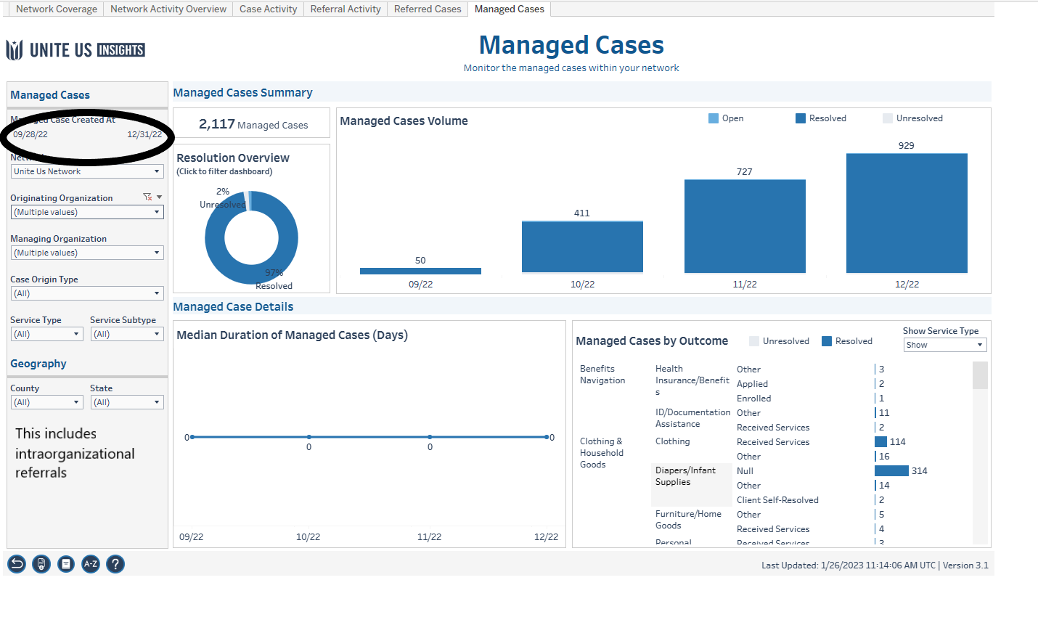

Slide 11
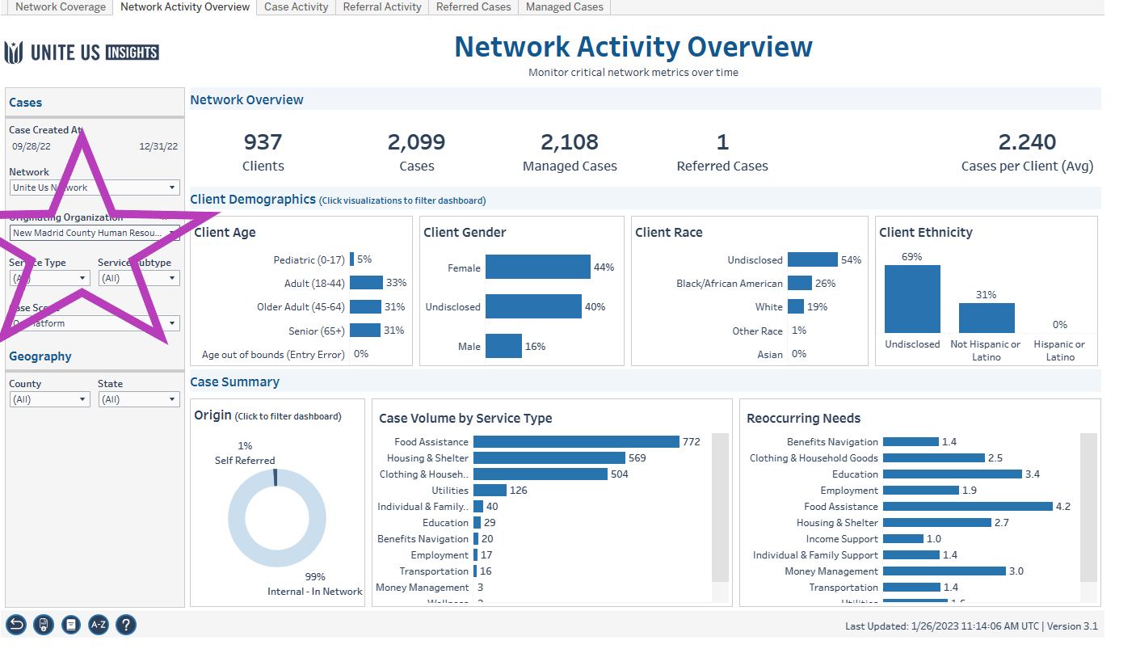

Slide 12
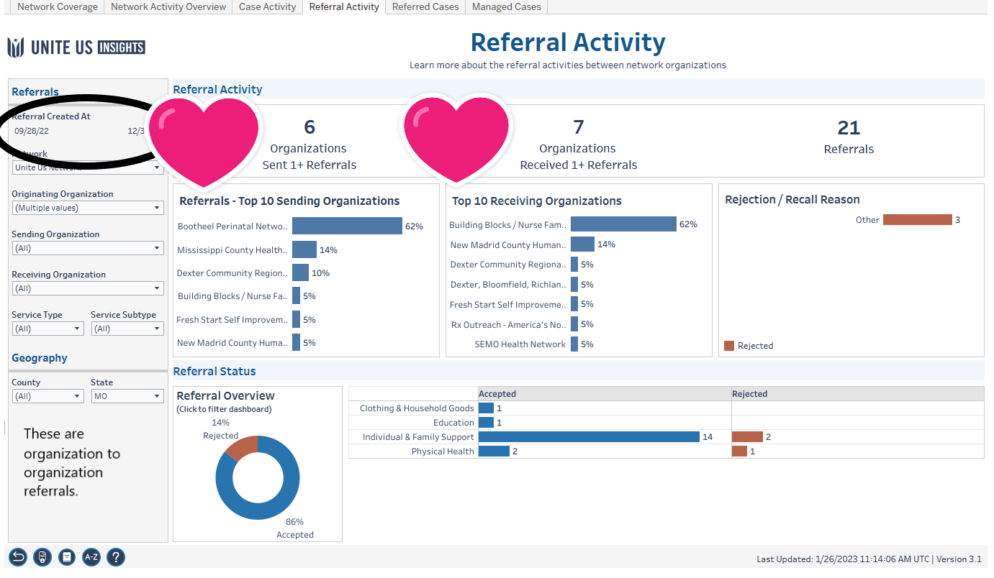

Slide 13
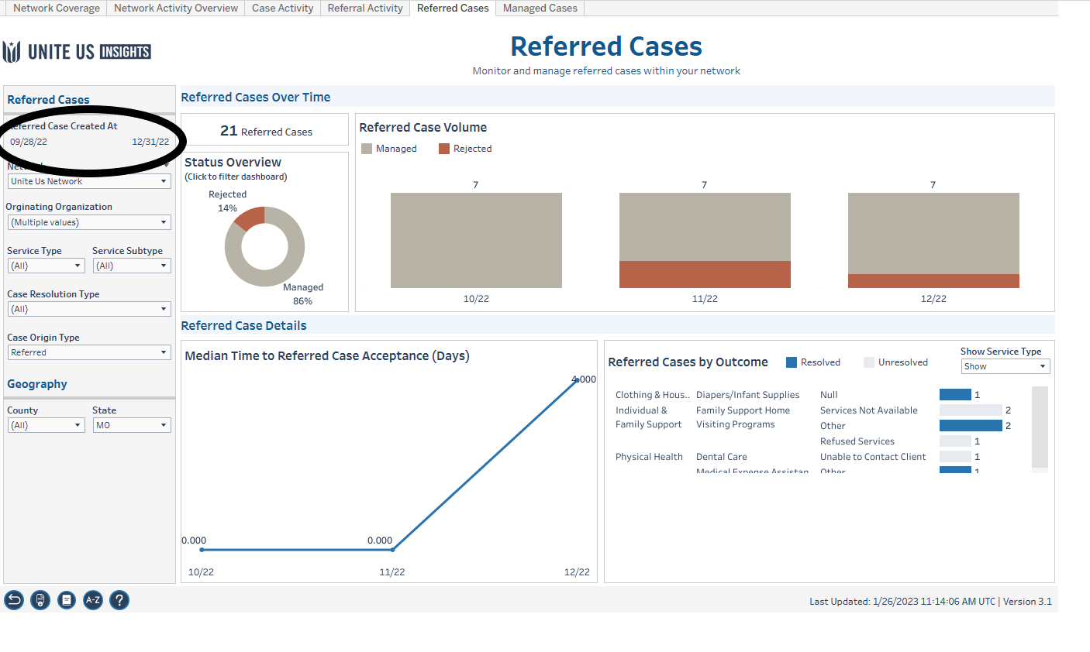

Slide 14
6 month
Health Equity Data

Slide 15
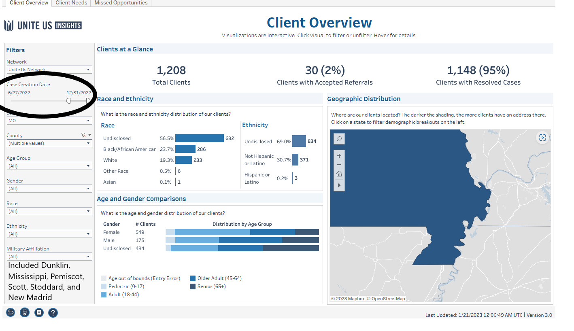

Slide 16
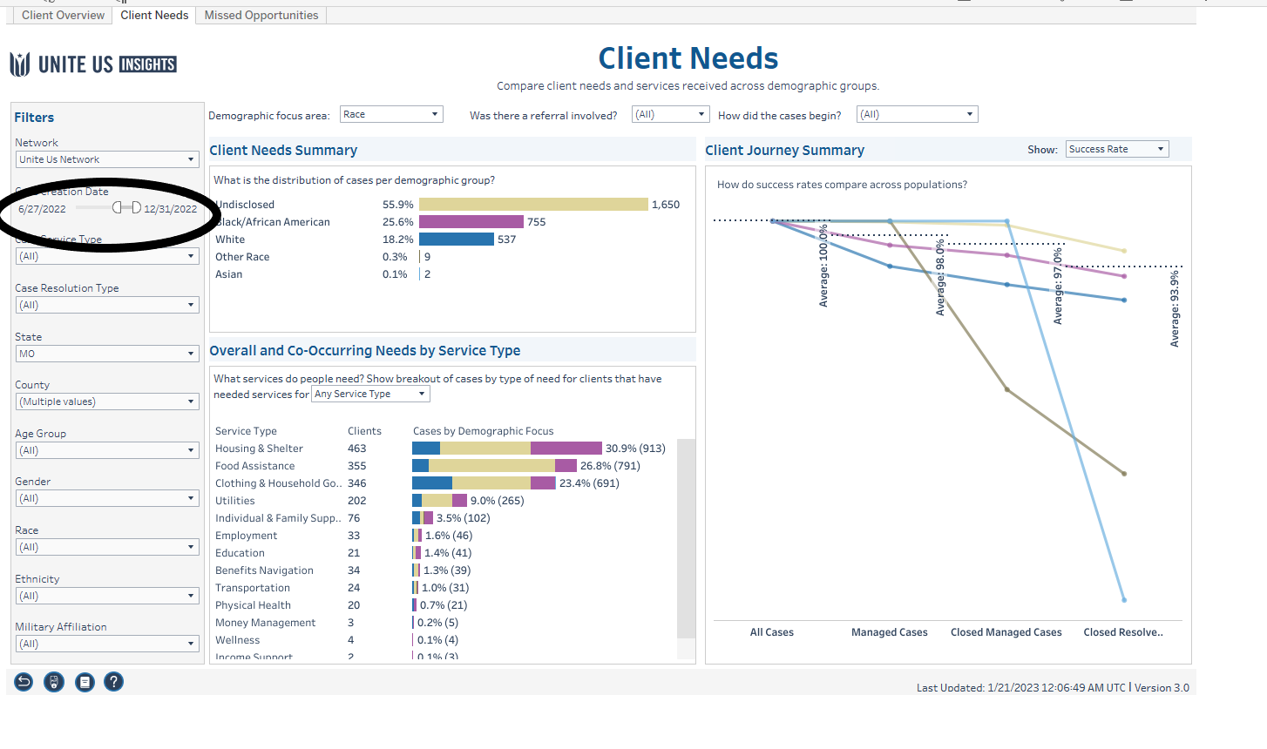

Slide 17
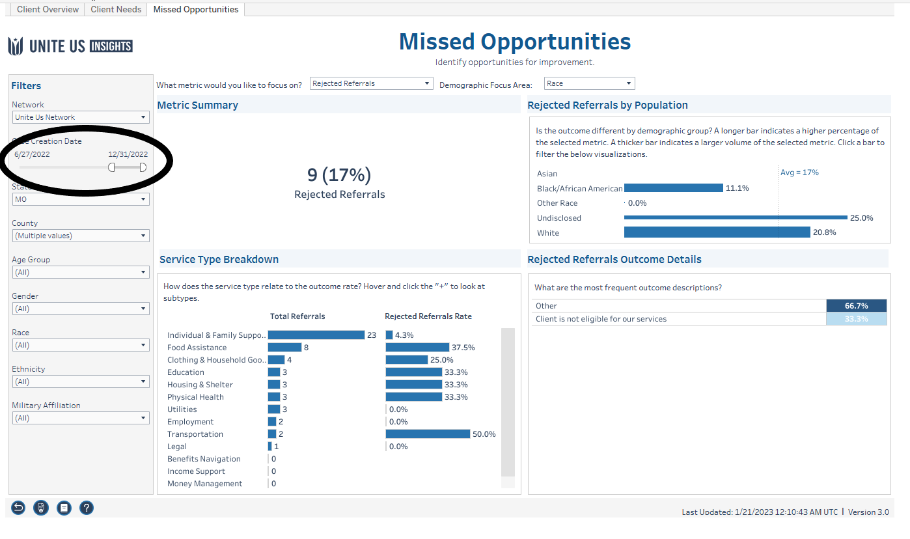

Slide 18
2nd
QUARTER
Mindi Allison, Unite Us

Slide 19
Follow up from 1st quarter questions/suggestions
A: Difference between sent and forwarded.
Sent is when you are primary one sending and forward is if you can’t help but can forward to a partner that can.
Create a quarterly survey for partners…to track benefits and ask if new connections were made. *Paul/SC
A: If a referral is rejected, the referring agency is who should make client aware.
Send out link and remind partners about UU learning opportunities and how to access.
Requested partners:
All health dept
MCCC
Suzanna Wesley
Cape Tigers for HiSet
Requested partners:
Mother to Mother
PIN-car seats
New Madrid PAT
Salvation Army
Care Portals
Requested partners:
FCC
Ministerial Alliance
Hope International
Spread Hope Now
Share data ppt with partners who were unable to attend and have accessible to others.
Rachelle access to community dashboards.
Rebecca access to insights and exports.
UU: BoRN needs data pulled for out of network referrals
UU: Can there be a filter option added to exports report?
UU: Can we find out who sent a specific referral (as BoRN)
i.e. to Presbyterian Childrens
Share health equity dashboard in 2nd quarter data sharing meeting.

Slide 21
Future data presentation dates
April 13, 2023 11a-1p in person location tbd
July 13, 2023 11a-noon zoom
Oct 12, 2023 11a-1p in person, location tbd
*Calendar invites are sent to the contact given for the organization. Always feel free to share.

