Slide 1
BoRN + Unite Us Data Report
1/1/2023-3/31/23
3rd Quarter

Slide 2
Active Bootheel Resource Network partners on the Unite Us platform:
Bootheel Perinatal Network
Building Blocks/ Nurse Family Partnership
New Madrid County Human Resource Council
Dexter, Bloomfield, Richland R-1 Parents as Teachers
Pemiscot Initiative Network
SEMO Area Health Education Center
SEMO Health Network
Dexter Community Regional Healthcare Foundation (RHF)
Visiting Nurse Association of Southeast Missouri
Jackson R2 School District
Stoddard County Public Health Center
Fresh Start Self Improvement Center, Inc
Charleston R-1
Mississippi County Health Department
The Resource Link of SEMO
Dunklin County Health Department
Pemiscot County Health Dept
Dunklin/Stoddard Caring Council
Butler County Health Department
Caring Communities Mississippi County
Birthright of Cape and Marble Hill
Bootheel Babies and Families
New Madrid County Health Department (pending registration)
Don’t forget about statewide partners! You find more by clicking the “MyNetwork” tab at the top of your Unite Us page. These include organizations like Mers Goodwill, Lutheran Family and Children’s Services, and more.

Slide 3
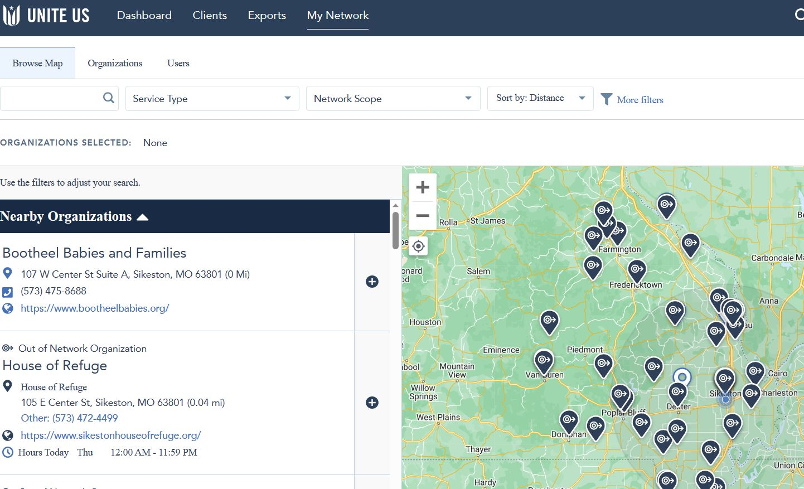

Slide 4
Partners added in 3rd Quarter
Caring Communities Mississippi County
Birthright of Cape and Marble Hill
*Bootheel Babies and Families

Slide 5
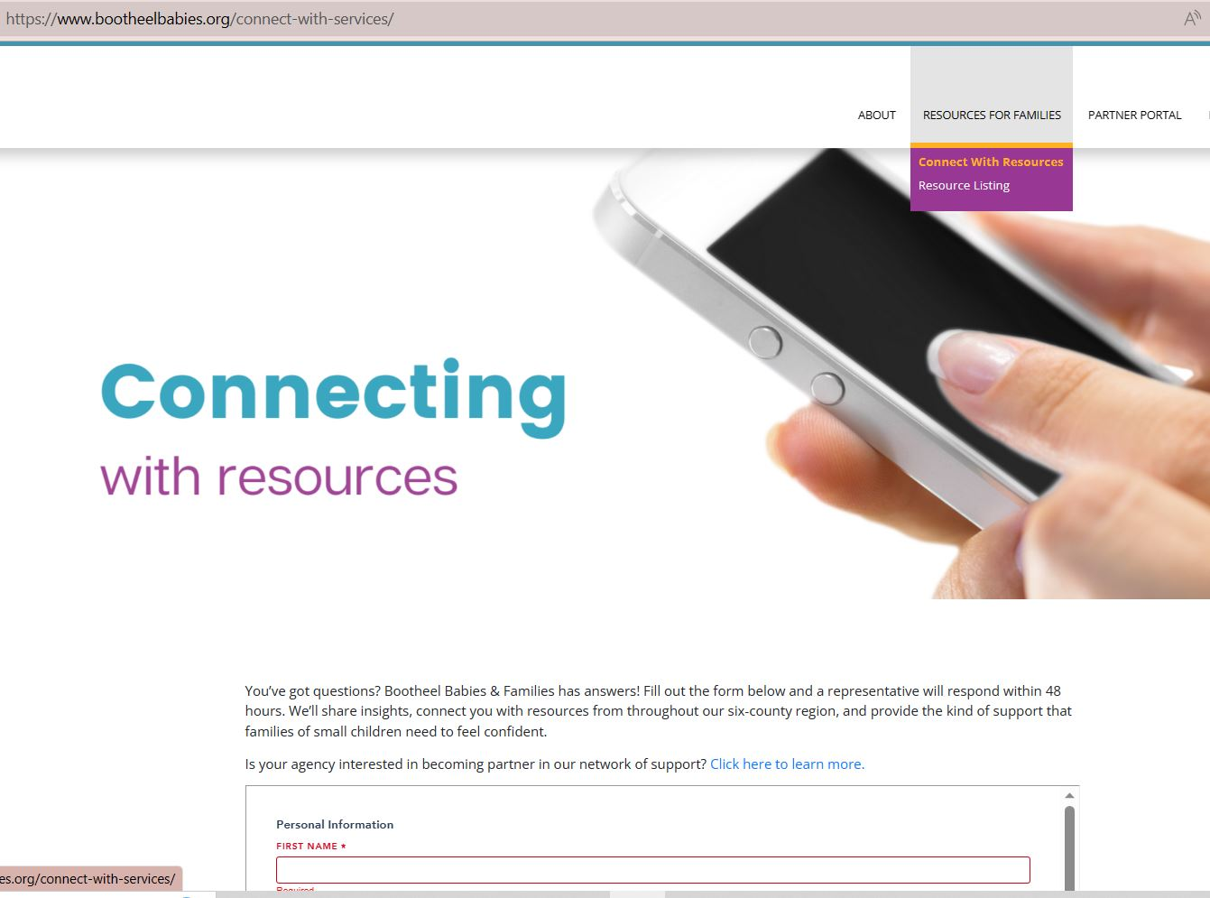
Self referral link on BBF website bootheelbabies.org
Bootheel Babies – Bootheel Babies and Families is a comprehensive community effort to reduce infant mortality in Southeast Missouri

Slide 6
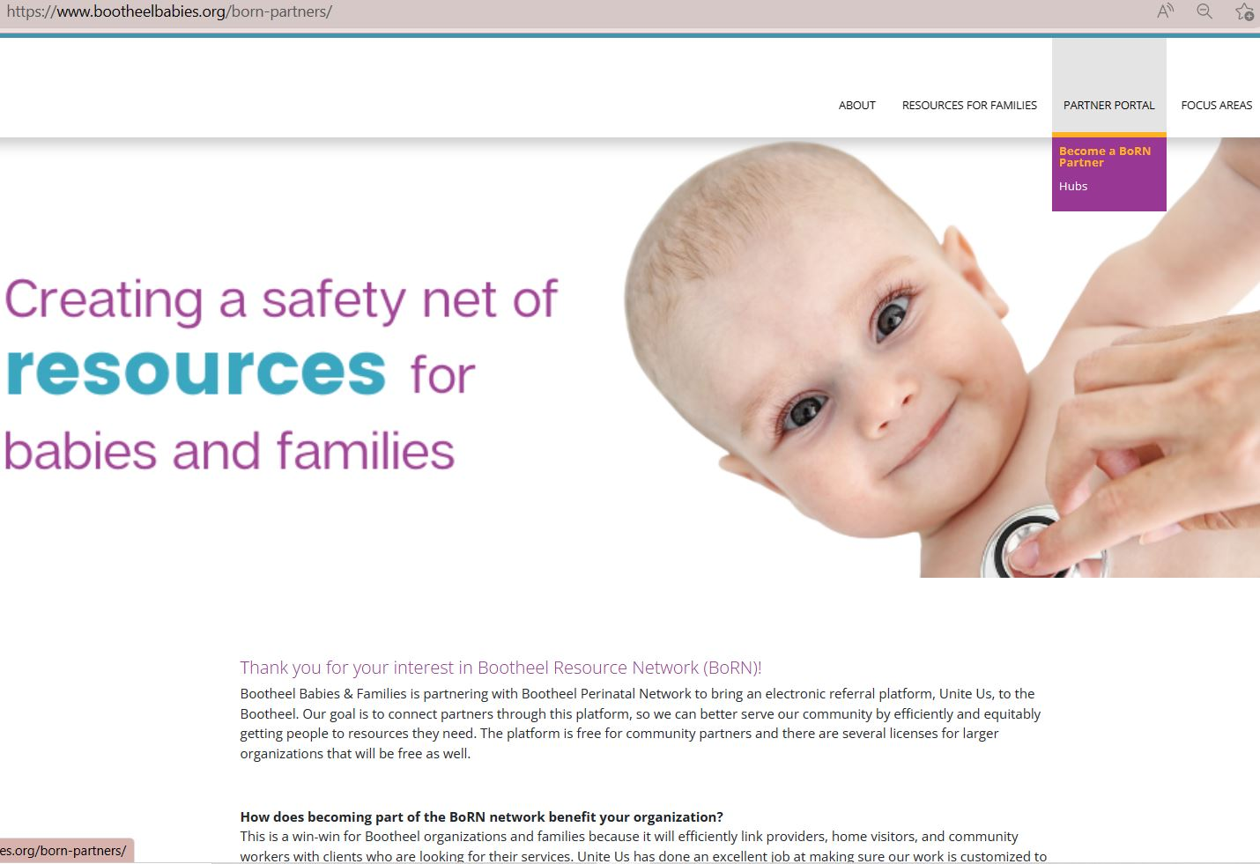
Information for potential partners on BBF website

Slide 7
3rd
QUARTER
DATA
1/1/2023-3/31/2023

Slide 8
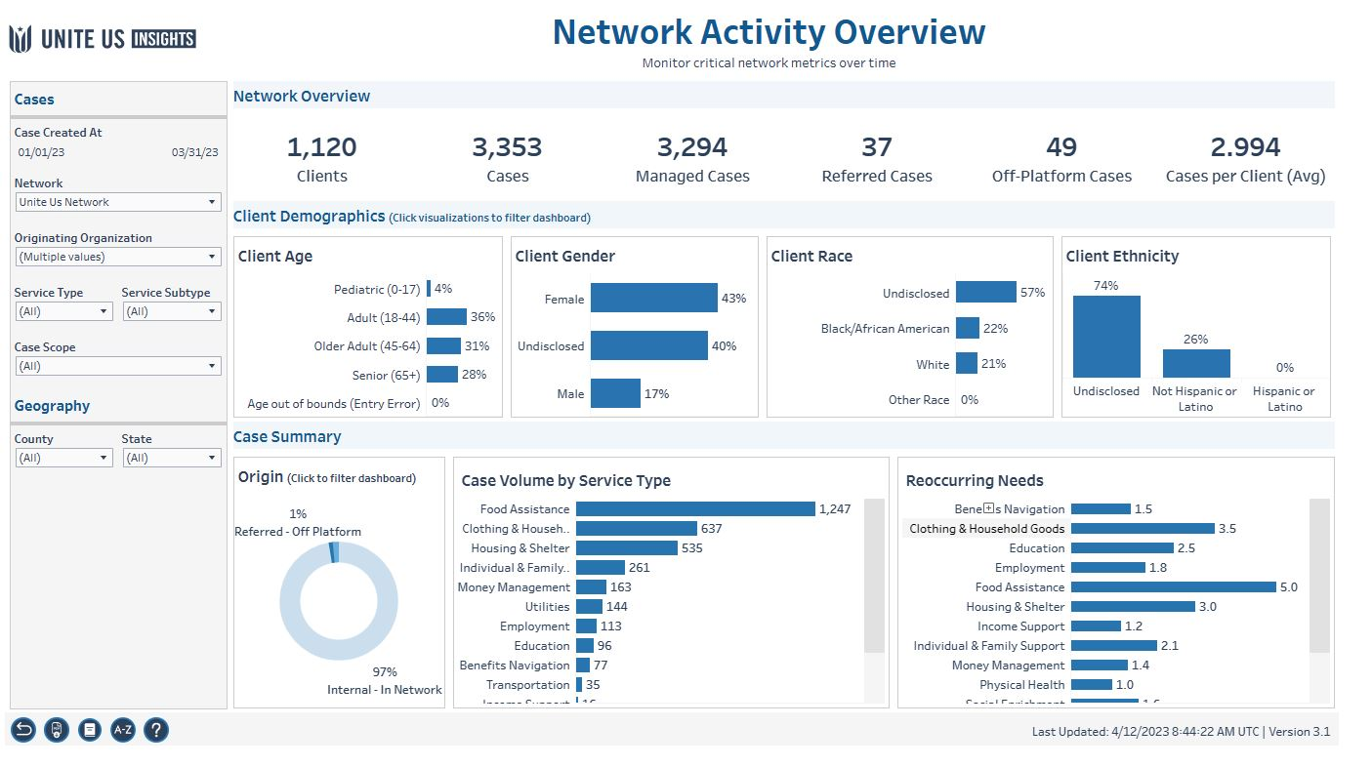
Workbook: Insights Center (uniteus.io)

Slide 9
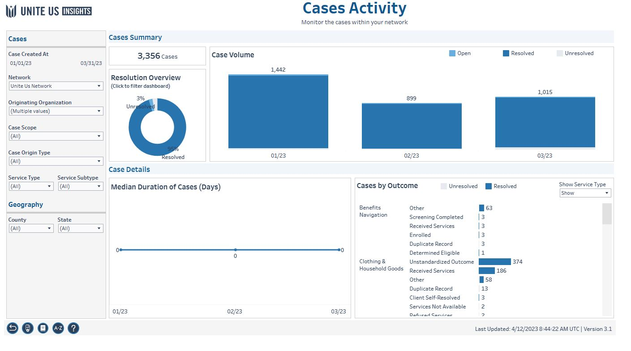

Slide 10
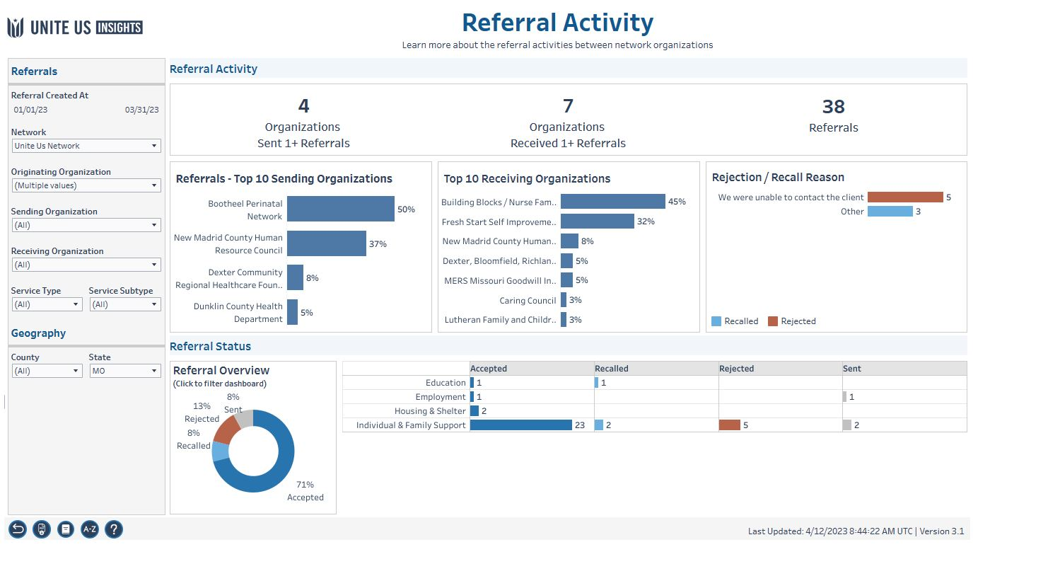
Notes:
The referral sent by Mississippi County Health Department was declined due to client declining services for the time being
Opportunity to encourage thorough evaluation of clients needs and desired timeline for receiving services
Referrals sent by Building Blocks / Nurse Family Partnership were rejected due to client ineligibility
Opportunity to encourage recipient (or the rejecting) organizations to update their program eligibility requirements
Referrals rejected by Building Blocks / Nurse Family Partnership were due to being at capacity for multiparous clients
Opportunity to encourage them to add info on clients they currently cannot accept to their program description

Slide 11
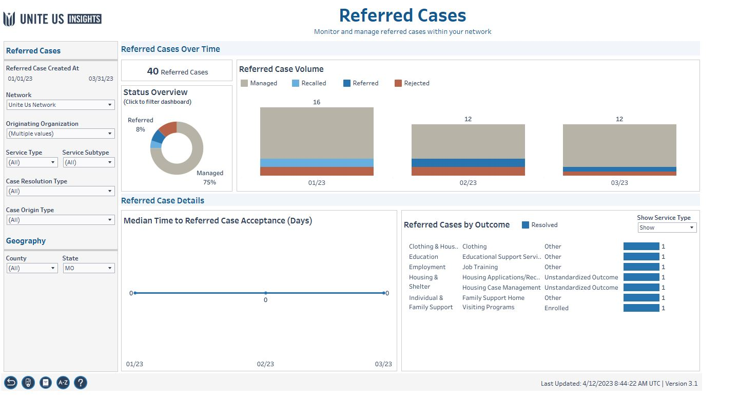

Slide 12
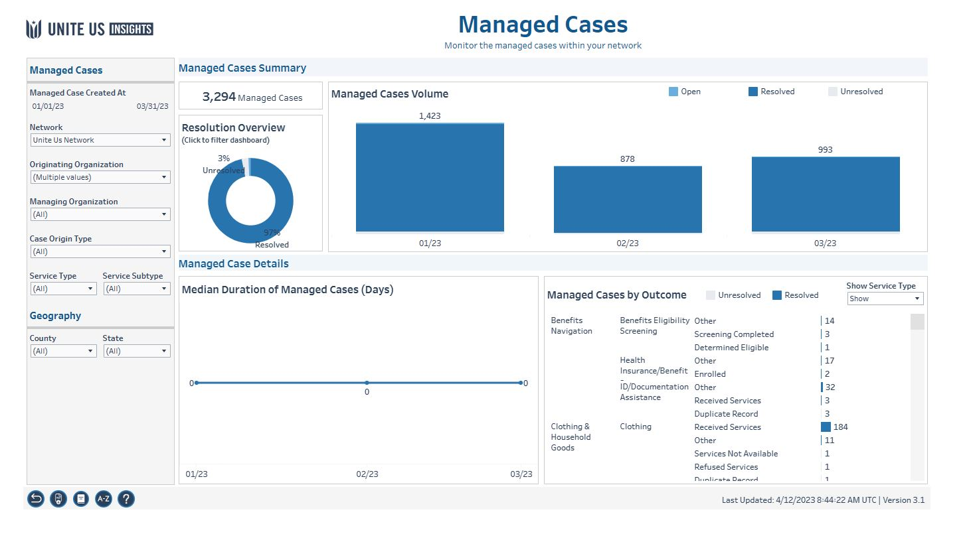

Slide 13
Health Equity Data

Slide 14
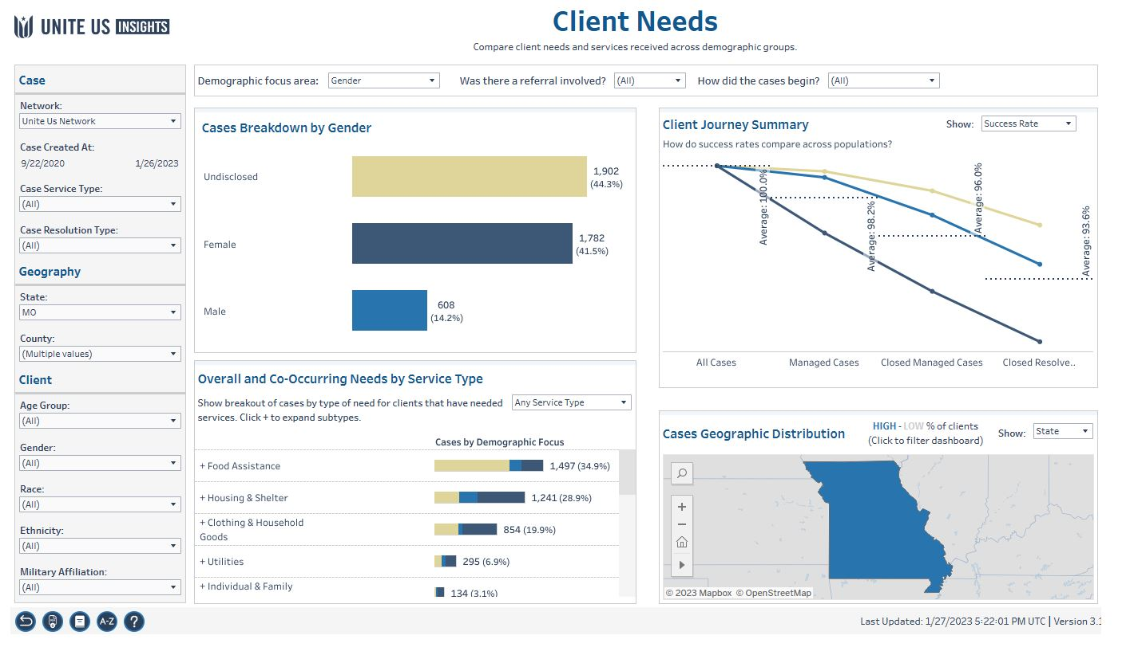

Slide 15
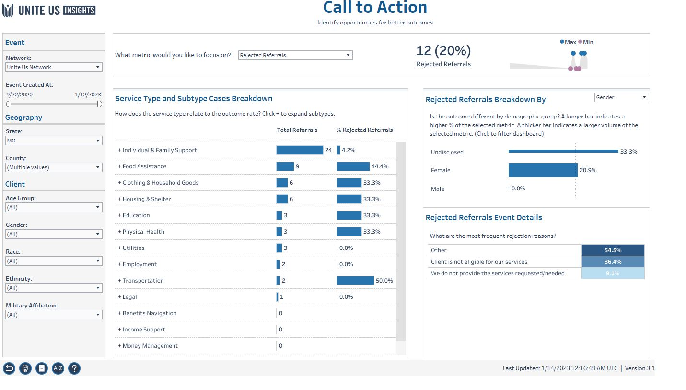

Slide 16
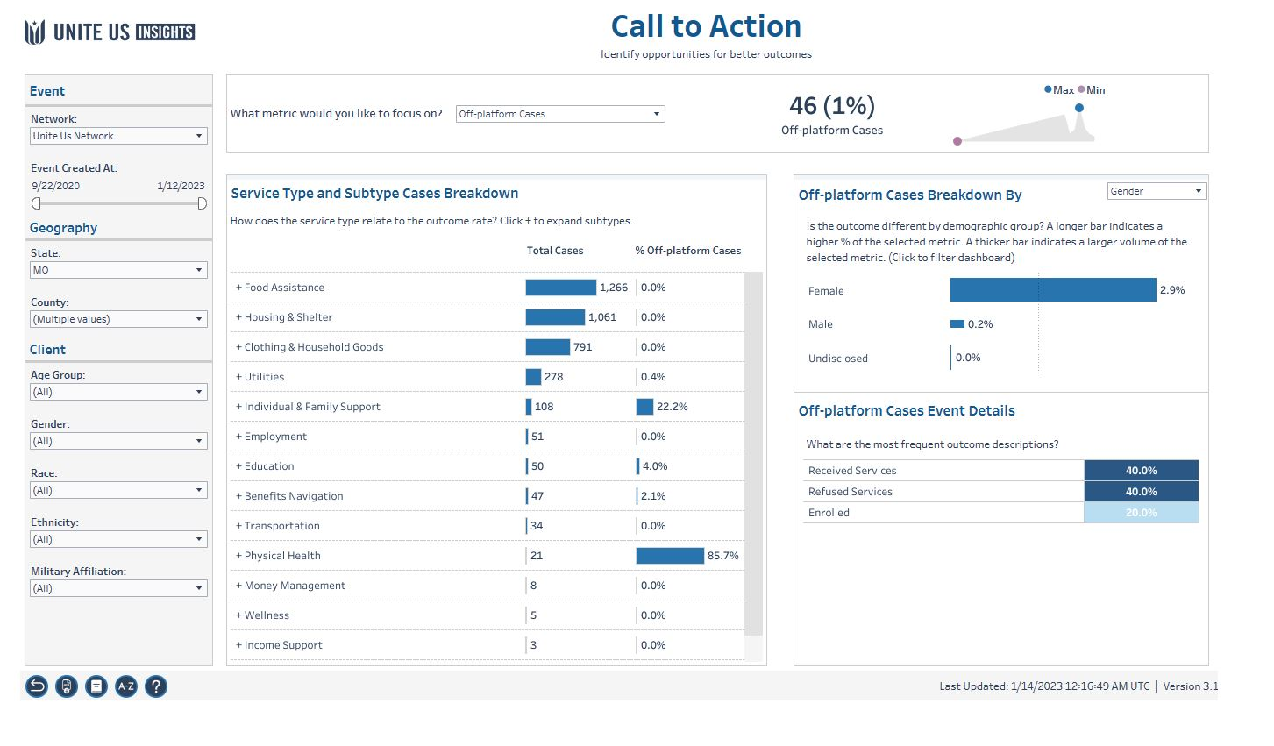

Slide 17
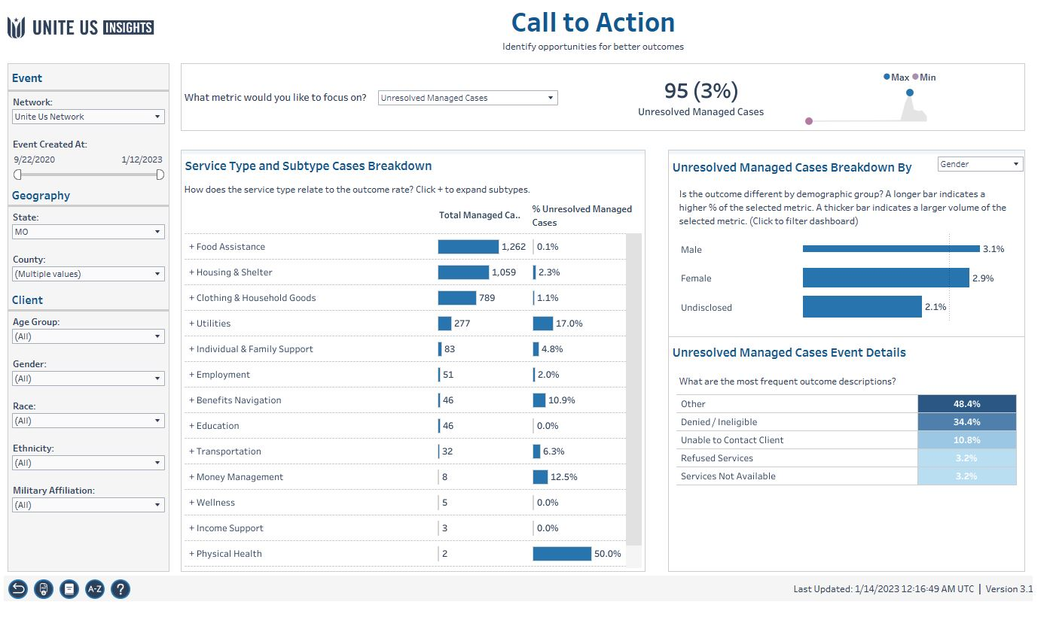

Slide 18
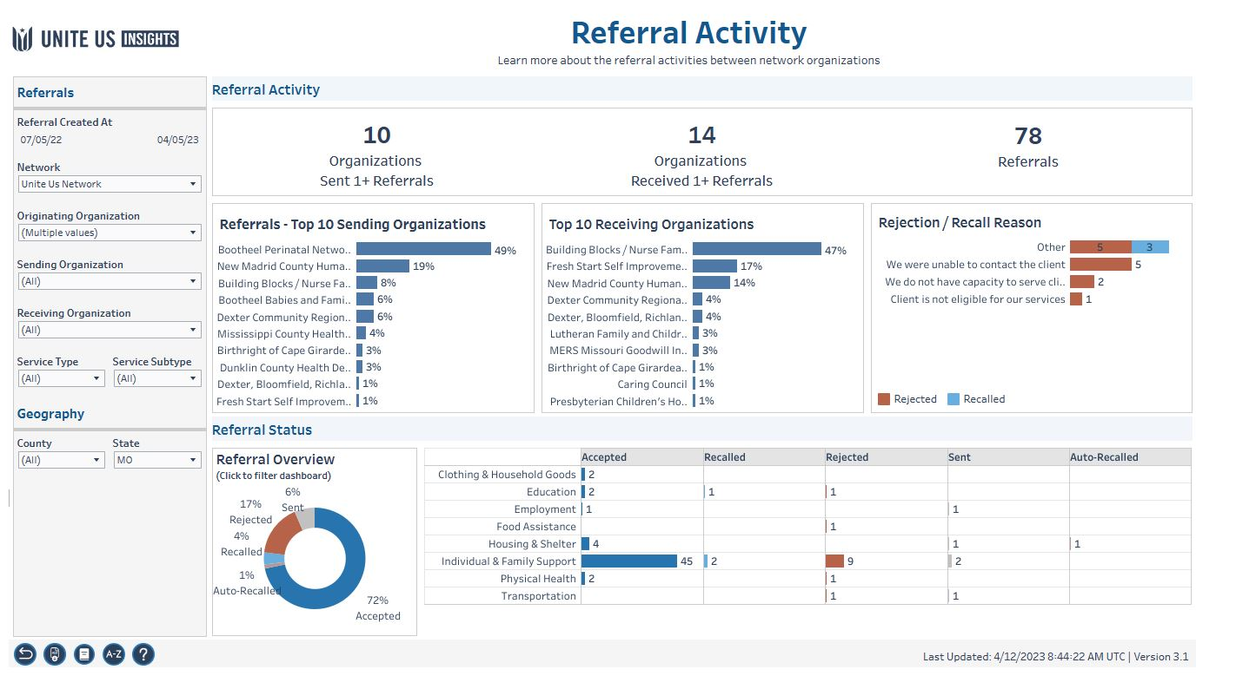

Slide 19
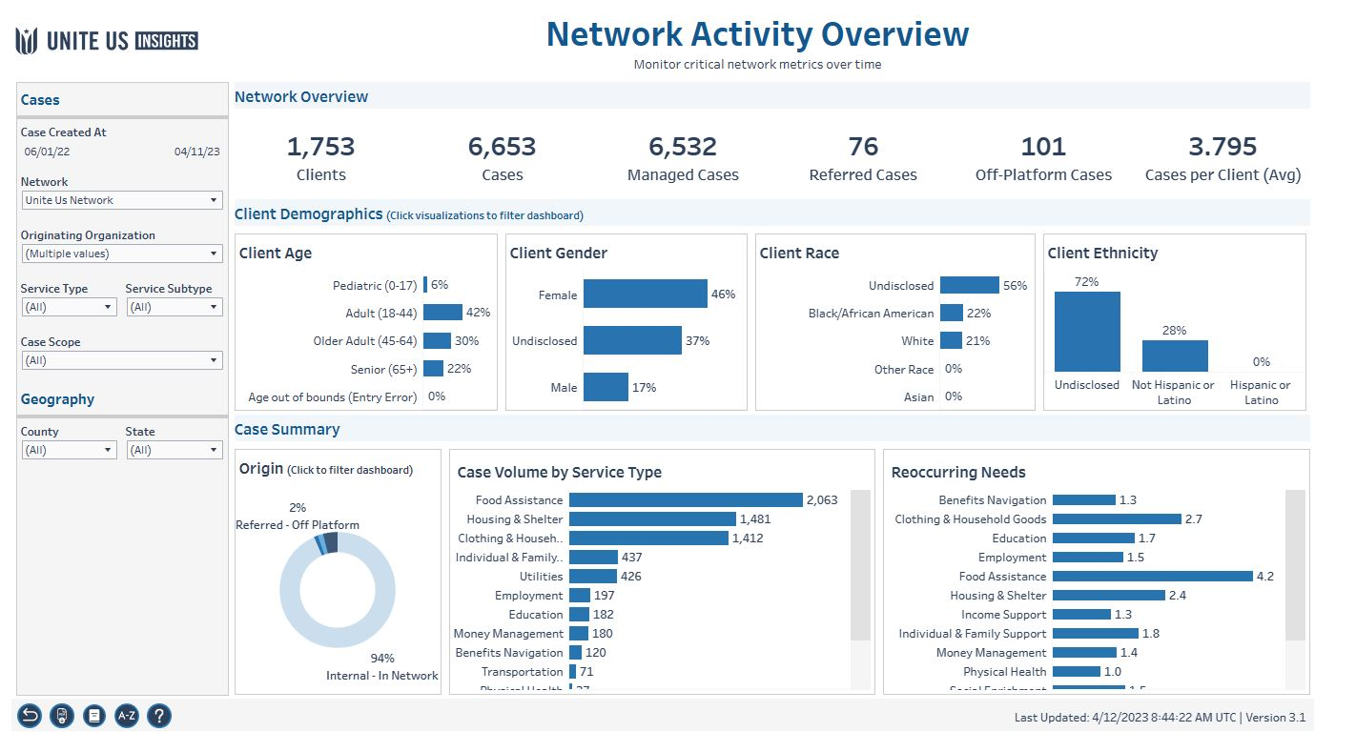

Slide 20
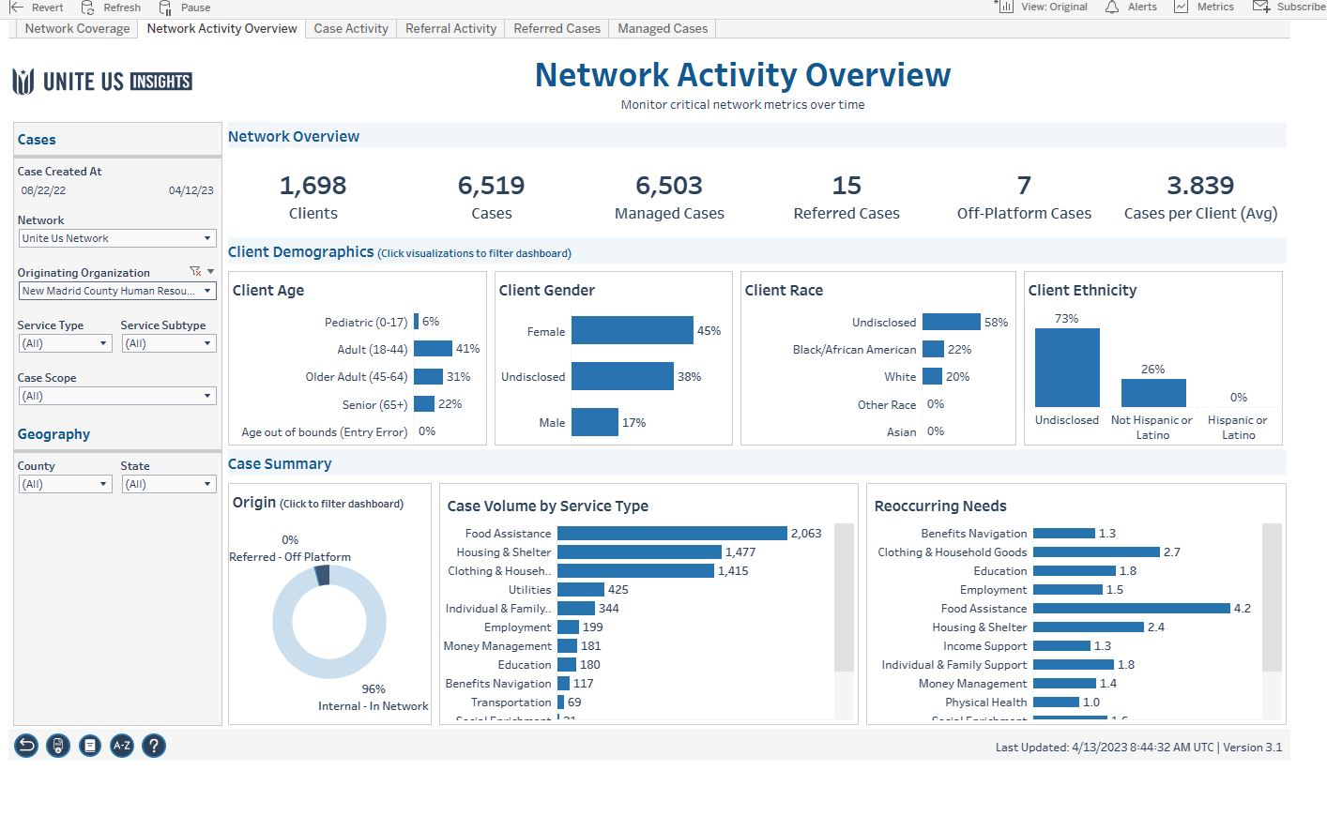

Slide 21
Partner Spotlight:
New Madrid County Family Resource Center
Speaker: Tonya Vannasdall,
Executive Director

Slide 22
Client Story
How Unite Us streamlines intake with internal referrals
Situation: Ellen is a single mother who is seeking new employment and in need of child care. Due to her current schedule, she is strapped for time and unable to visit multiple locations in search of the help that she needs.
Ellen visits New Madrid Family Resource Center, the largest social service support agency in her area.
The front desk staff has her complete the intake form using a Unite Us Assistance Request Form housed on their iPad at the front desk.
The Intake Specialist reviews the Assistance Request form, assesses Ellen for additional unmet needs, and gathers more information.
As they learn of Ellen’s other unmet needs, program coordinators can create additional internal program referrals.
A referral is made to the SkillUp job readiness program and the center’s local diaper bank.
These additional internal referrals allow Ellen to receive care from multiple programs, all at the same place.
Resolution: As Ellen receives care, the team receives automated updates and is able to close the loop on her total health journey.
The Executive Director can track all clients served using available data for grant reports and applications.
*Note that assistance request forms can also be made available via a QR code during instances in which there is a rush of people seeking assistance
Notes:
NOTE: This workflow is an example of utilizing Assistance Request forms to coordinate an organization’s intake. From a technical point of view, users can’t send referrals “internally.” However, users can receive an assistance request and choose to open an internal case at a specific program and assign it to a case manager who works with that program. This slide should only be used to explain that at a high-level; users can open records internally across multiple programs.

Slide 24
Future data presentation dates
July 13, 2023 11a-noon zoom
Oct 12, 2023 11a-1p in person, location tbd
*Calendar invites are sent to the contact given for the organization. Always feel free to share.

Slide 25
